Slide 1
KARNS CITY
AREA SCHOOL DISTRICT
FACILITY STUDY UPDATE
June 15, 2020

Slide 2
OPTION DEVELOPMENT
OPTION REVIEW
COST SUMMARY
PHASING
NEXT STEPS

Slide 3
OPTION DEVELOPMENT
GUIDING PRINCIPLES
Plan for a stabilized enrollment of 1300 – 1500 students
Facilities must meet current construction standards
Student safety is priority (Building entrances, accessibility and security)
Minimal student transitions (currently 1 transition)
Provide equitable spaces and opportunities to all students
Minimize District operational costs
School campus should be easy to navigate
Schools corridors should be easy to navigate
Student centered environments (instead of teacher focused)
Separation of Jr. High academic spaces from Sr. High
Separate the academic spaces from public spaces

Slide 4
OPTION DEVELOPMENT
?
*Options 1-9 presented in CJA May 2019 District Feasibility Study

Slide 5
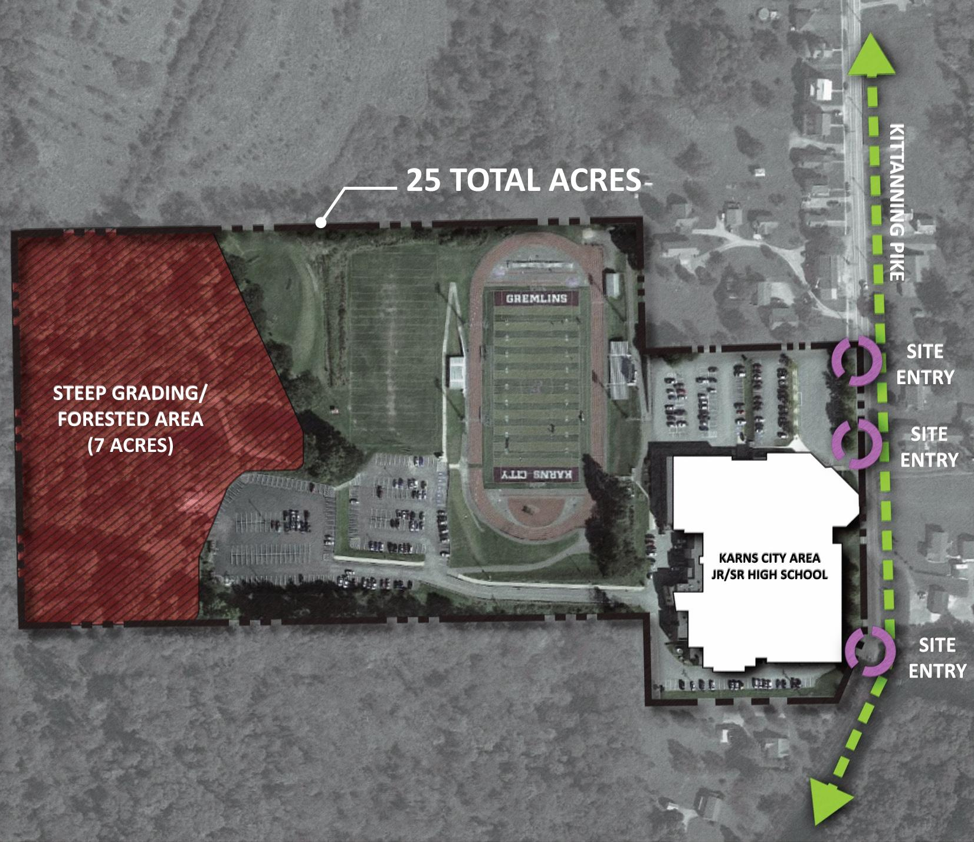
OPTION DEVELOPMENT
Limited land to develop due to steep slopes and forested area.
Vehicular circulation challenges:
Bus and Parent drop-off separation.
Traffic congestion during evening events.
Poor sight lines from south entrance driveway.
3. Regulatory Agency Review s
Stormwater Management
Lot coverage
*Eliminates Options 4, 6, 7, 8 and 9 on existing site

Slide 6
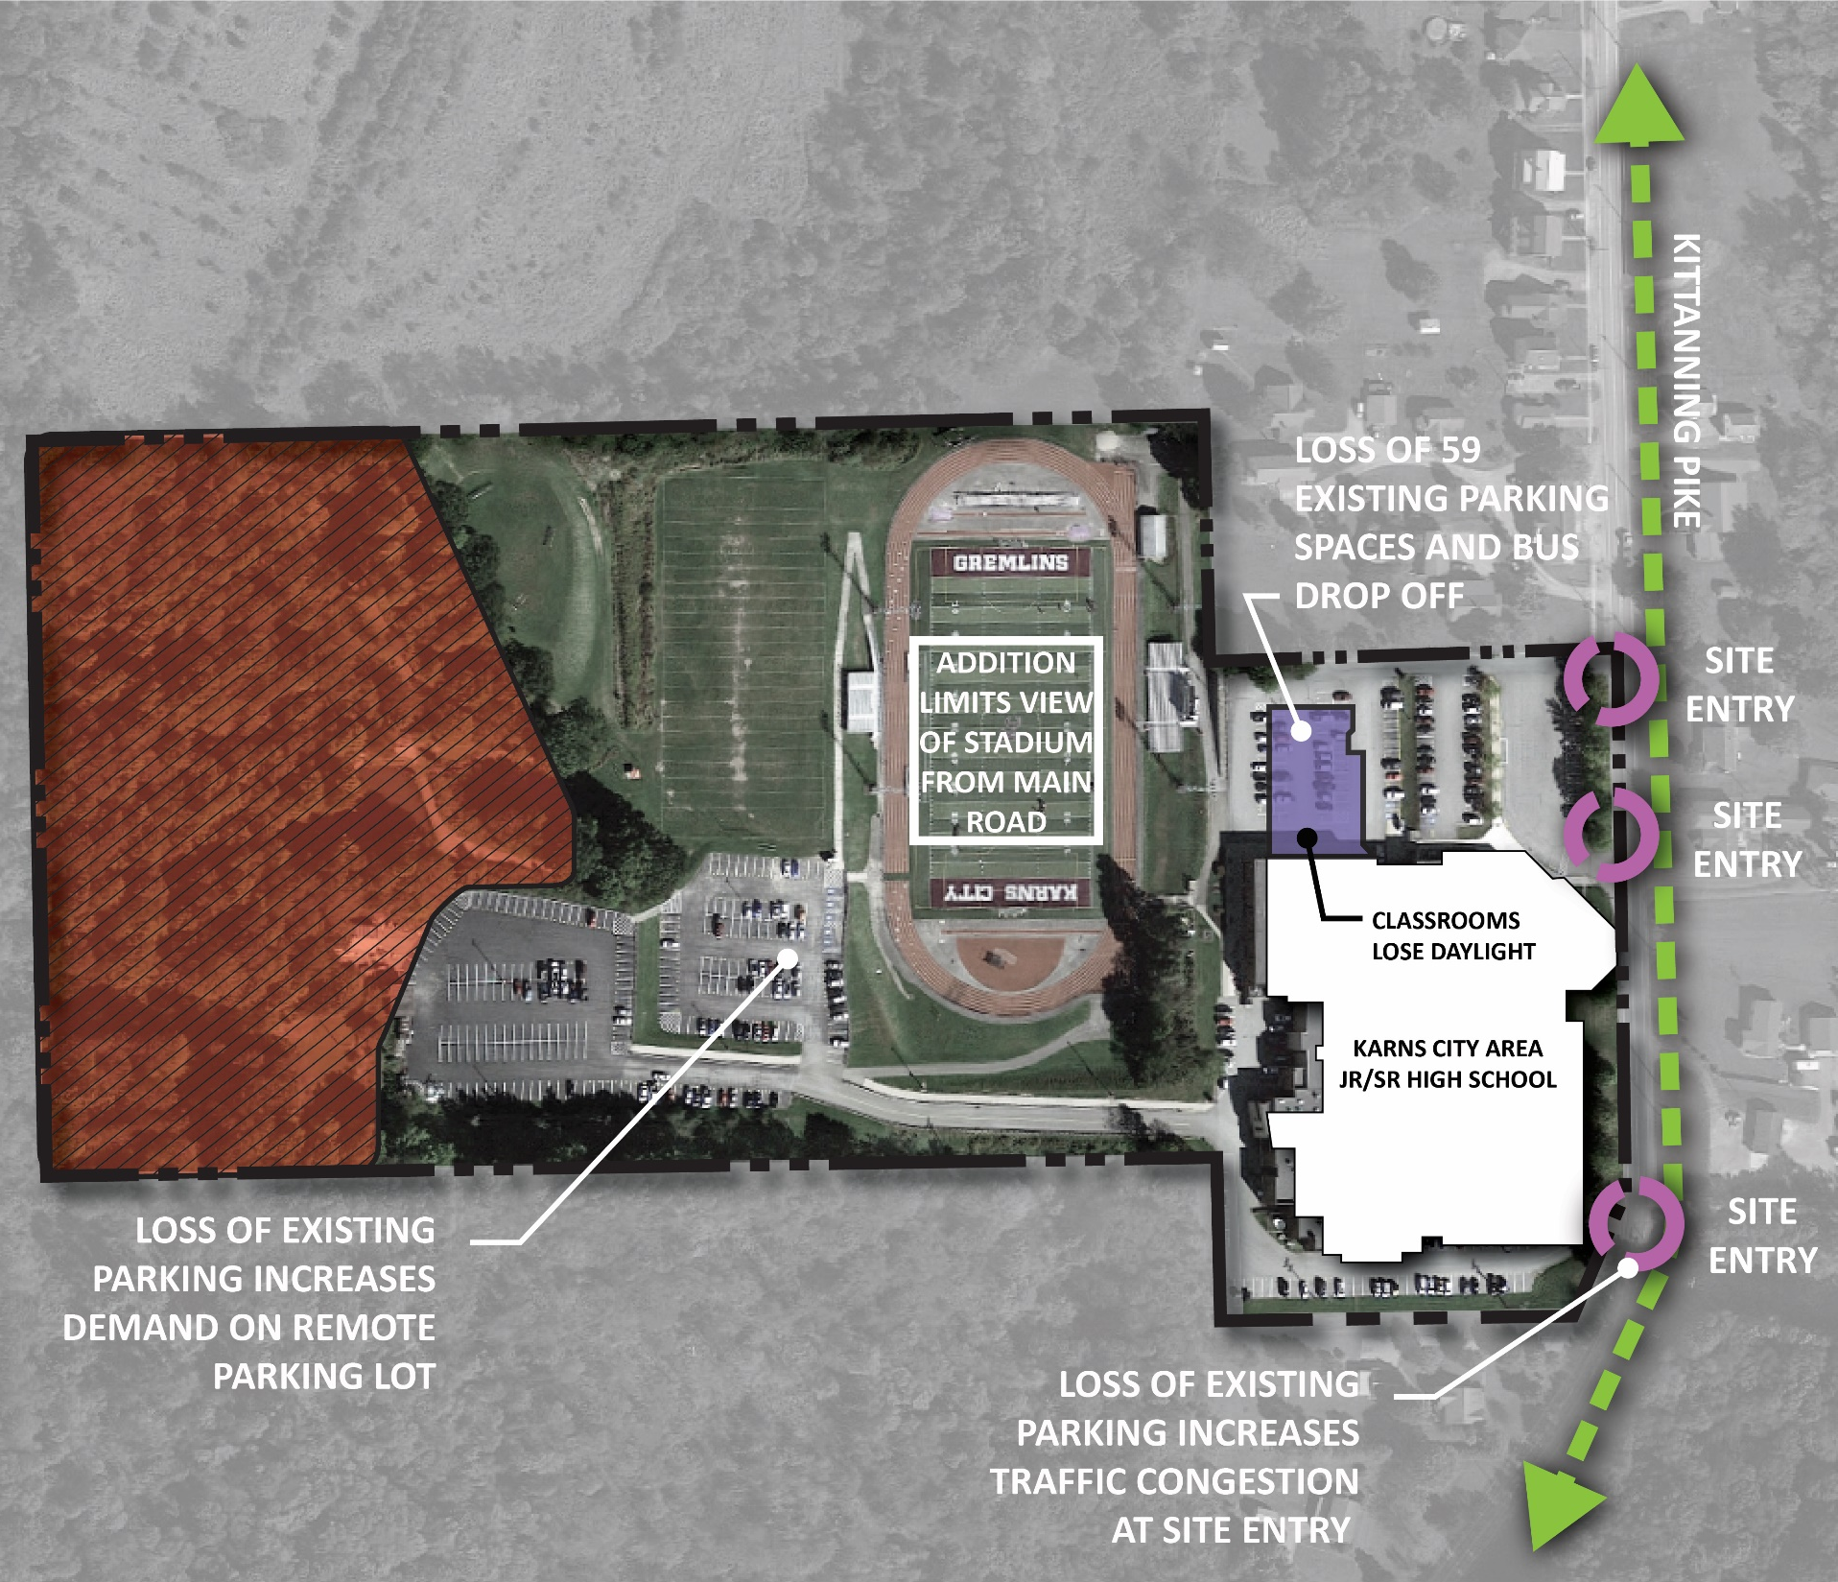
OPTION DEVELOPMENT
OPTION 4
Gymnasium & DAO addition:
Decreases existing parking by 59 spaces.
Eliminates bus drop-off zone.
Increases use of existing south driveway and Stadium parking.

Slide 7
OPTION DEVELOPMENT
OPTION 6
Admin, Gymnasium & DAO addition:
Decreases existing parking by 59 spaces.
Eliminates bus drop-off zone.
Increases use of existing south driveway and Stadium parking.
Organization of Admin layout not ideal for school operation (dead end corridor).

Slide 8
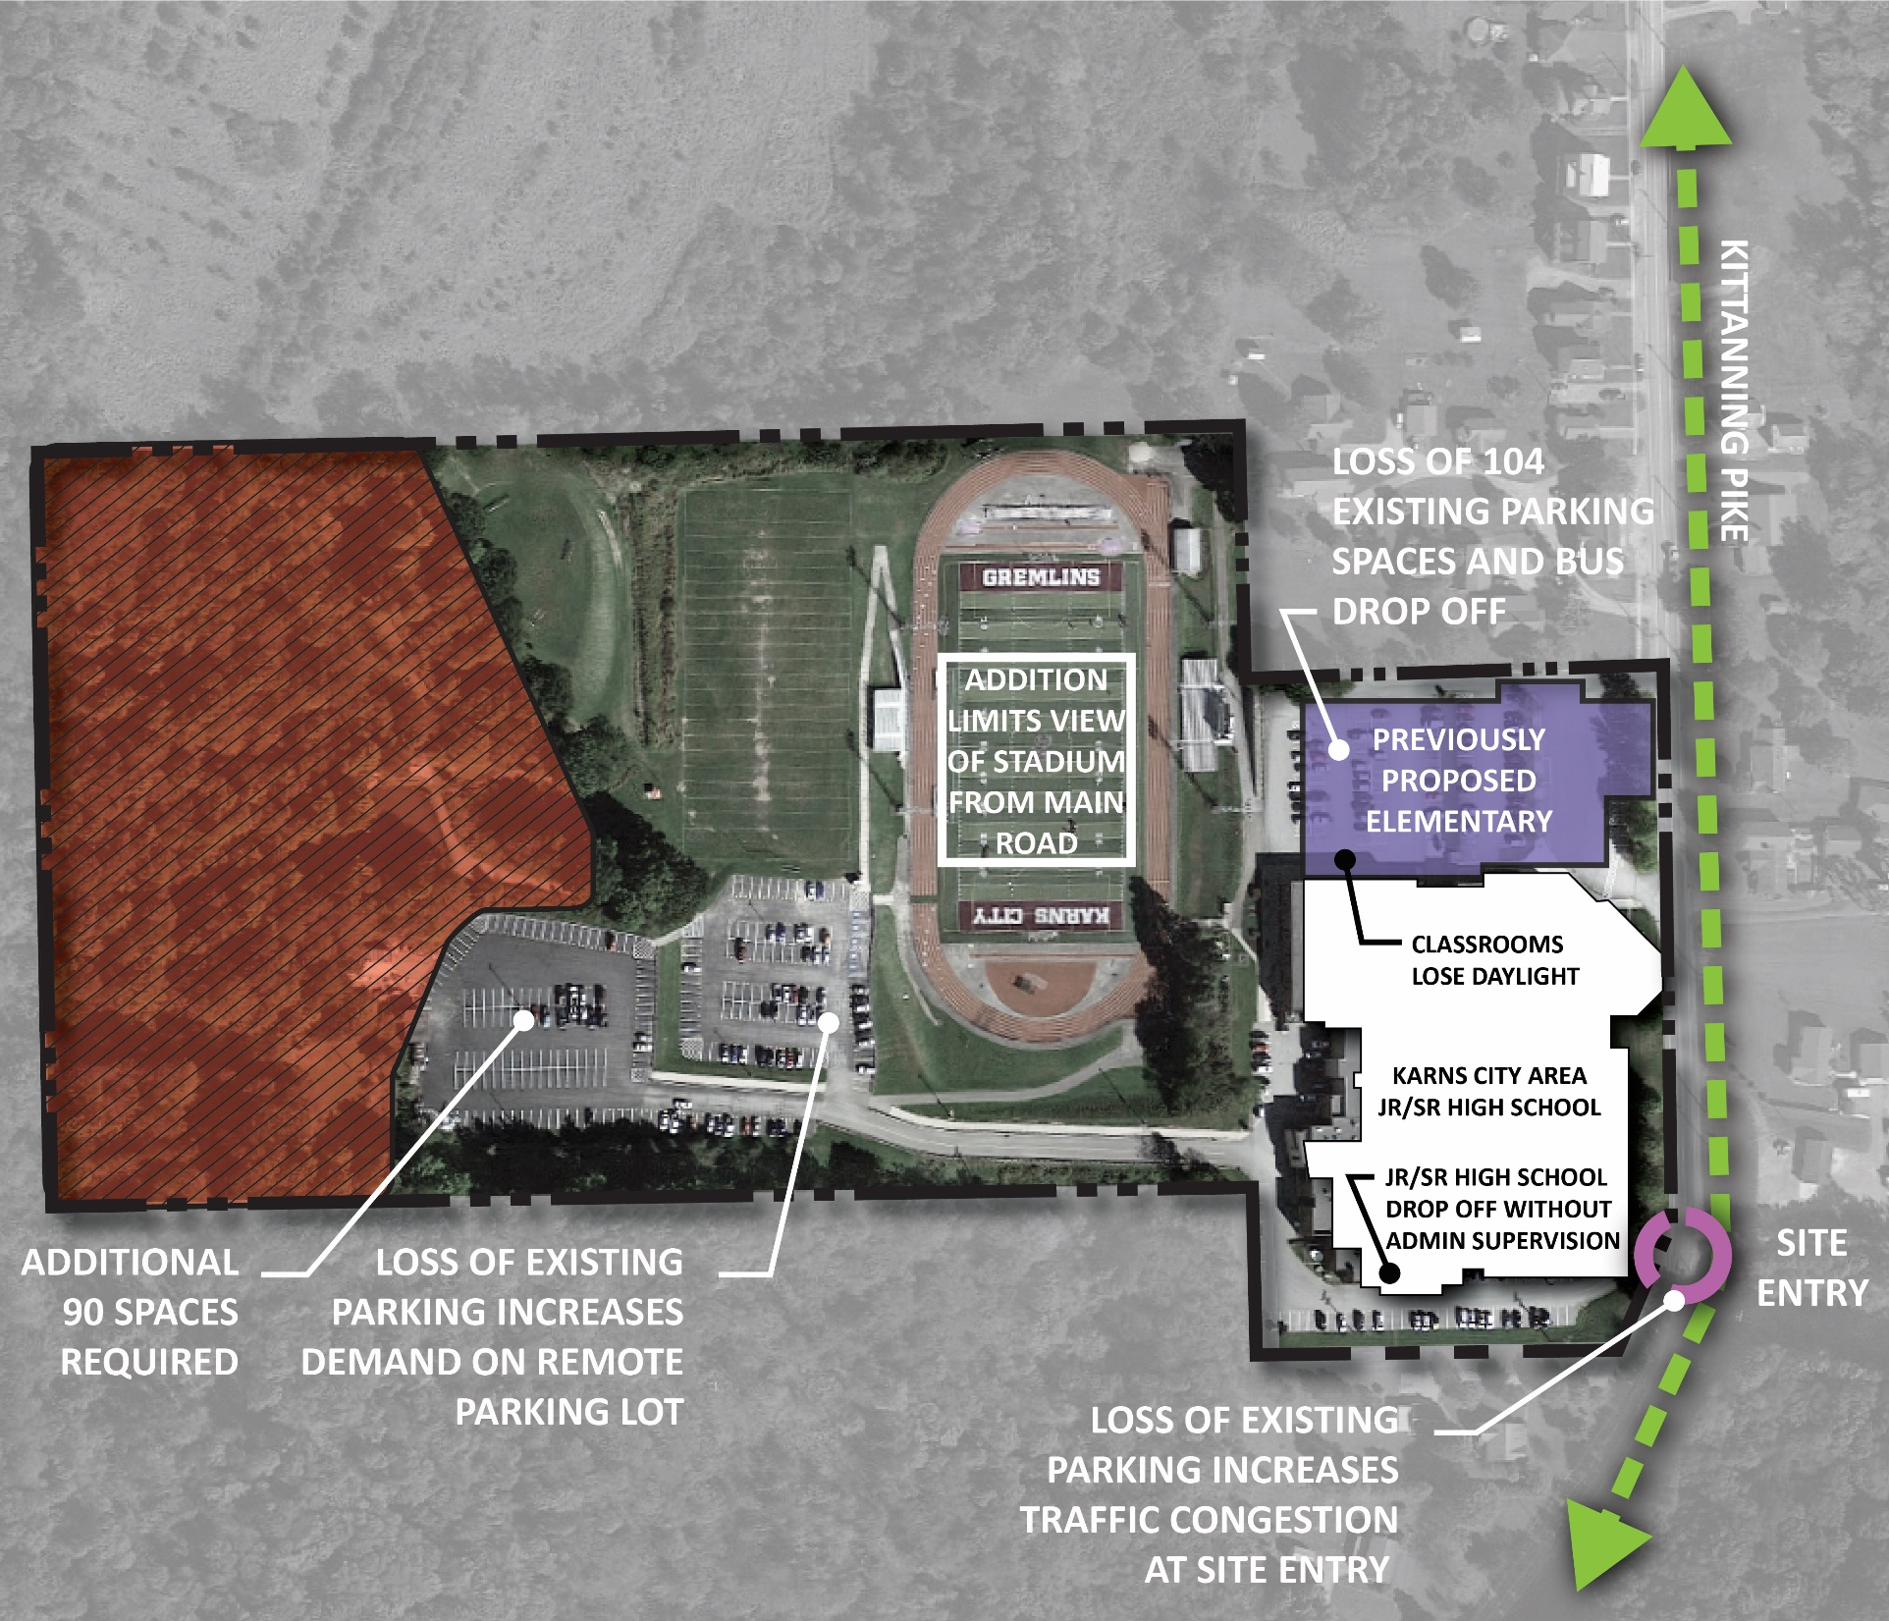
OPTION DEVELOPMENT
OPTION 7
Elementary School addition:
Eliminates all of existing spaces in north parking lot which will result in parking being remote from main entrance.
Eliminates bus drop-off zone adjacent to main entrance.
Increases use of existing south driveway and Stadium parking.

Slide 9
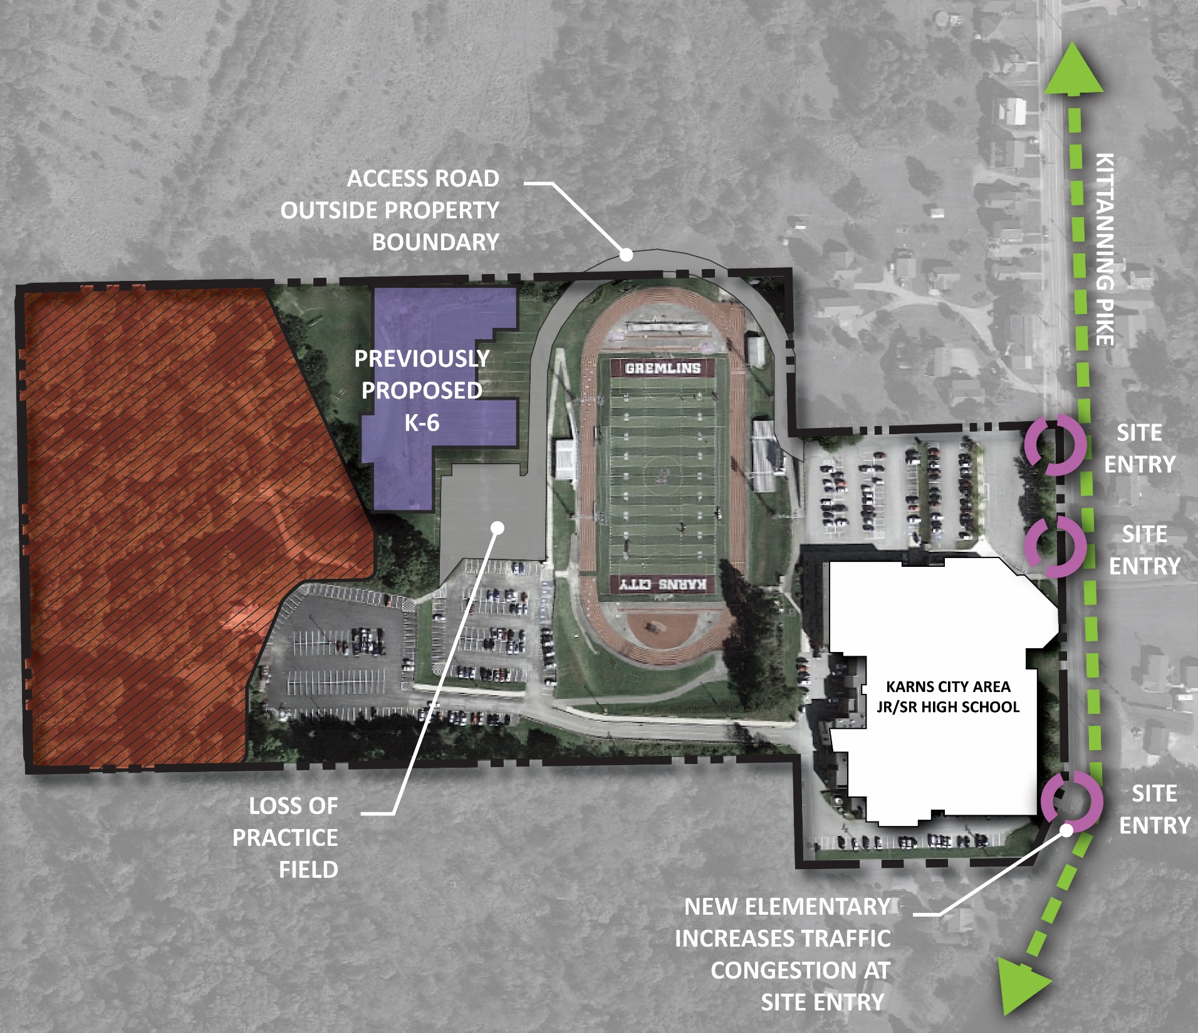
OPTION DEVELOPMENT
OPTION 8
New K-6:
Requires new school to be 3 floors.
Increases use of existing south driveway and Stadium parking.
Loss of practice field.
No space for emergency vehicular access.

Slide 10
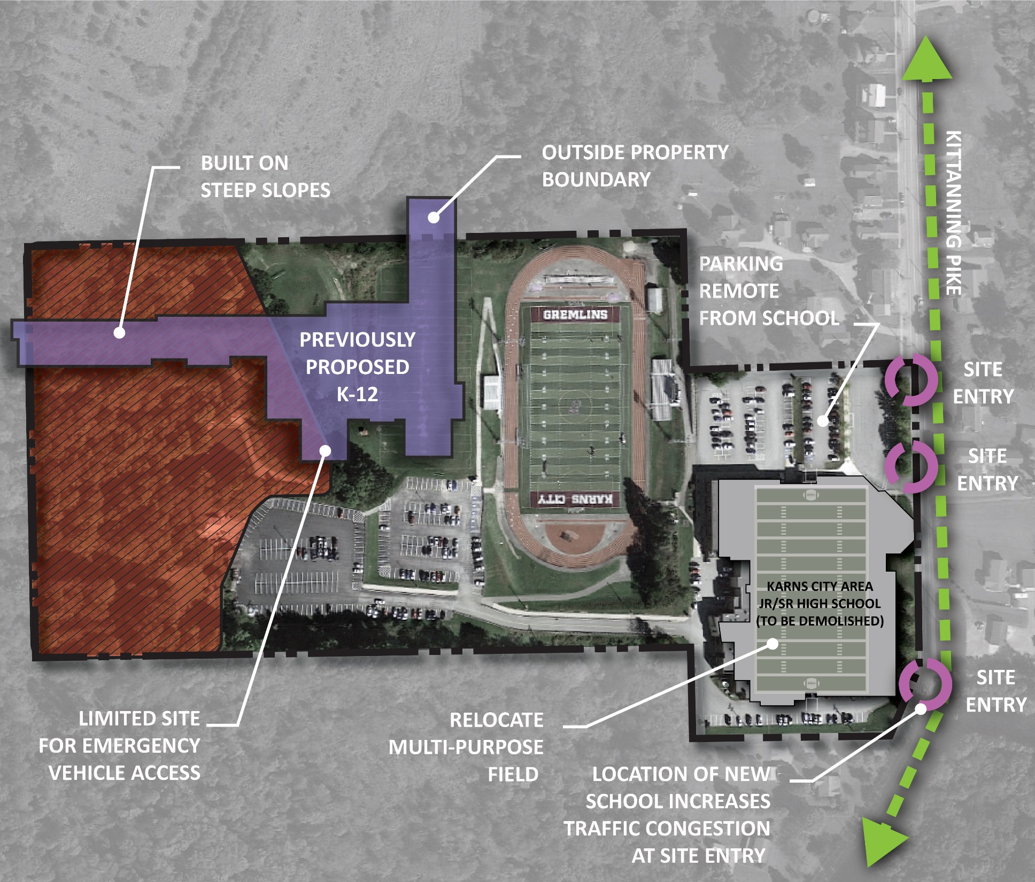
OPTION DEVELOPMENT
OPTION 9
New K-12:
Requires construction on steep slopes and forested area which will increase construction costs.
Increases use of existing south driveway and Stadium parking.
North parking remote from School.
No space for emergency vehicular access.

Slide 11
2 OPTION REVIEW

Slide 12
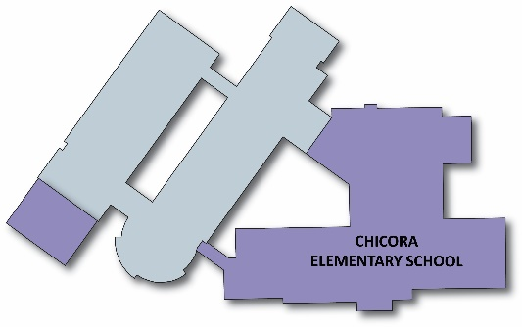
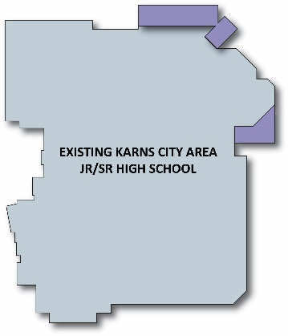
OPTION 3
OPTION 3
K-6: Chicora ES – Additions and renovations
7-12: Jr/Sr High School – Renovations w/minor additions

Slide 13
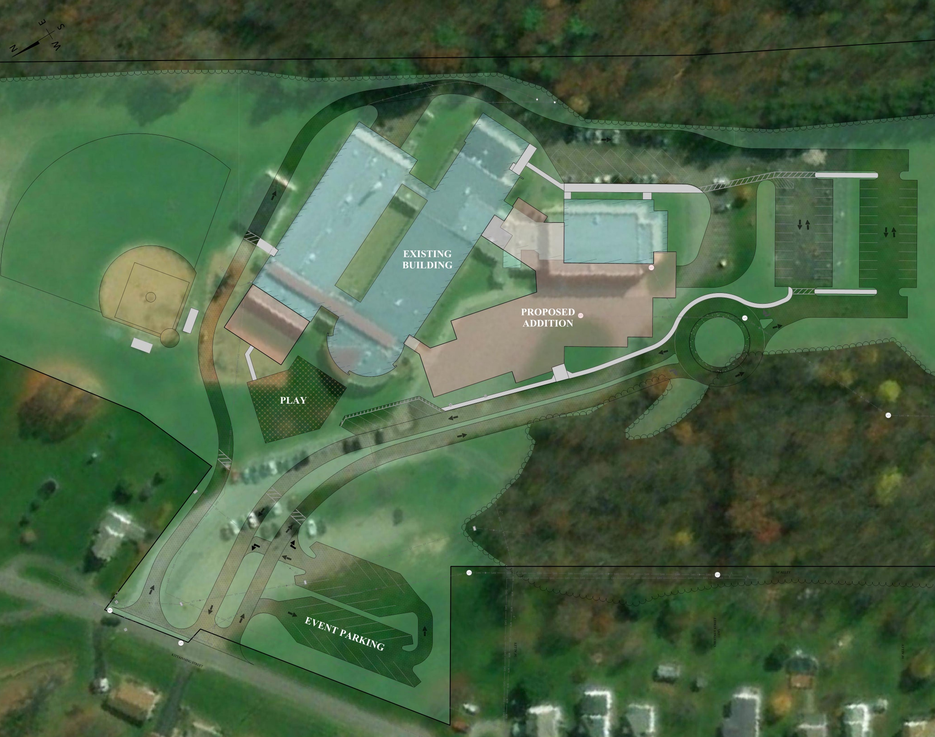
OPTION 3
Chicora ES Site Plan
Separate bus and parent drop-off drive-ways.
New main entrance that is identifiable and visible to visitors
New visitor and staff parking.
New service drive
Relocated play area
Pave existing overflow parking

Slide 14
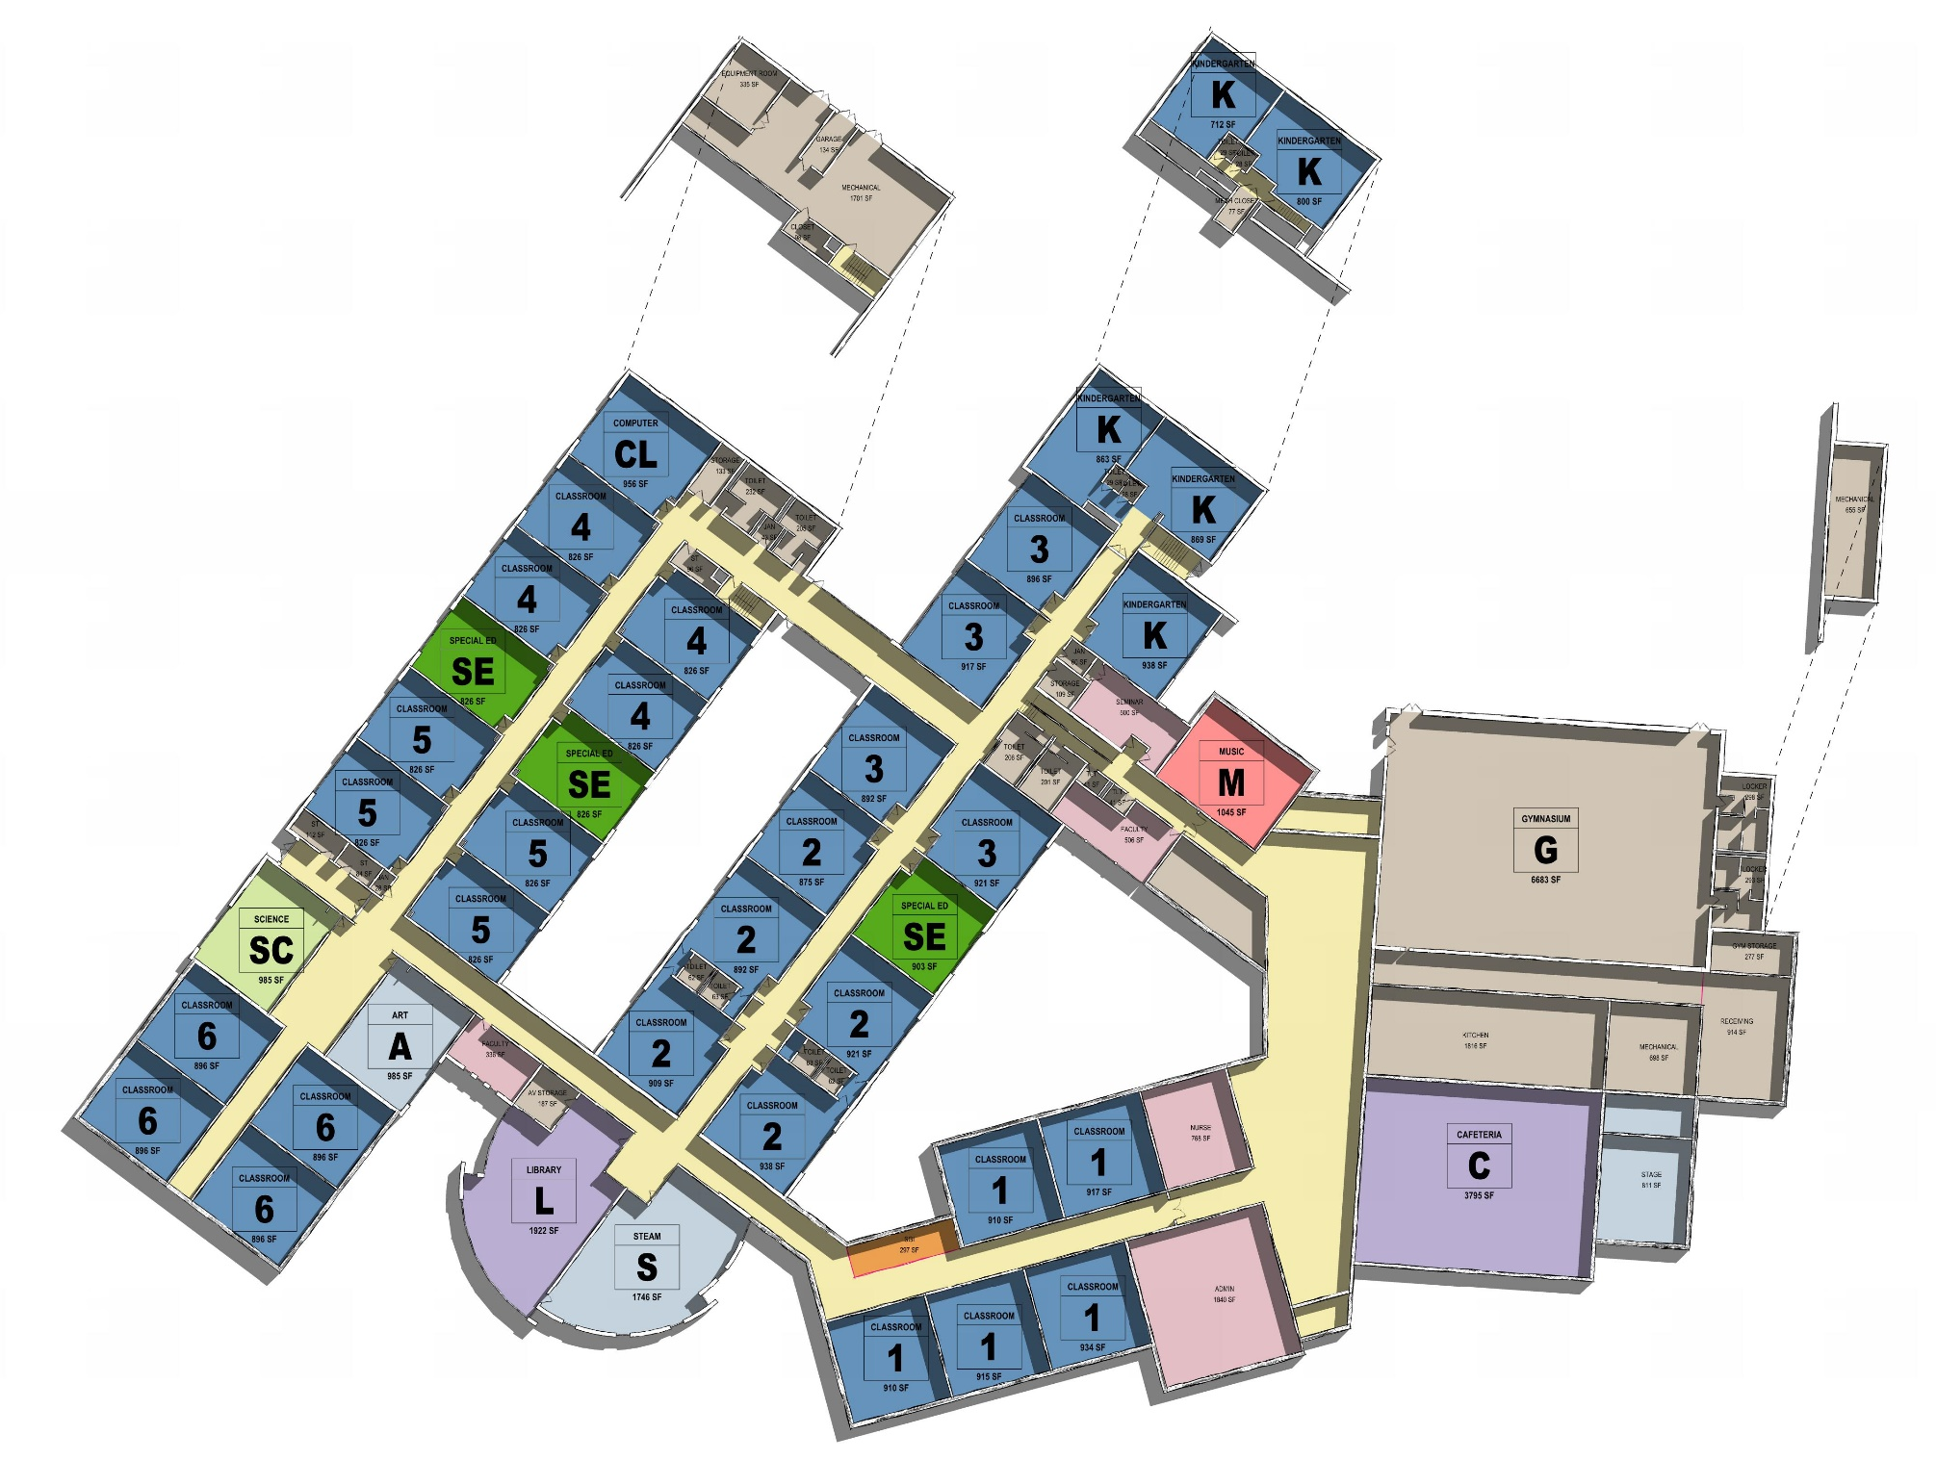
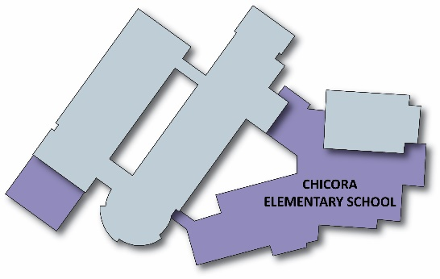
OPTION 3
Chicora ES Floor Plan
Expand Admin., Guidance & Nurse.
Create Secure Vestibule
Separate Academic Spaces from Public Spaces.
Develop Main Street for building organization.
Include open collaboration areas.

Slide 15
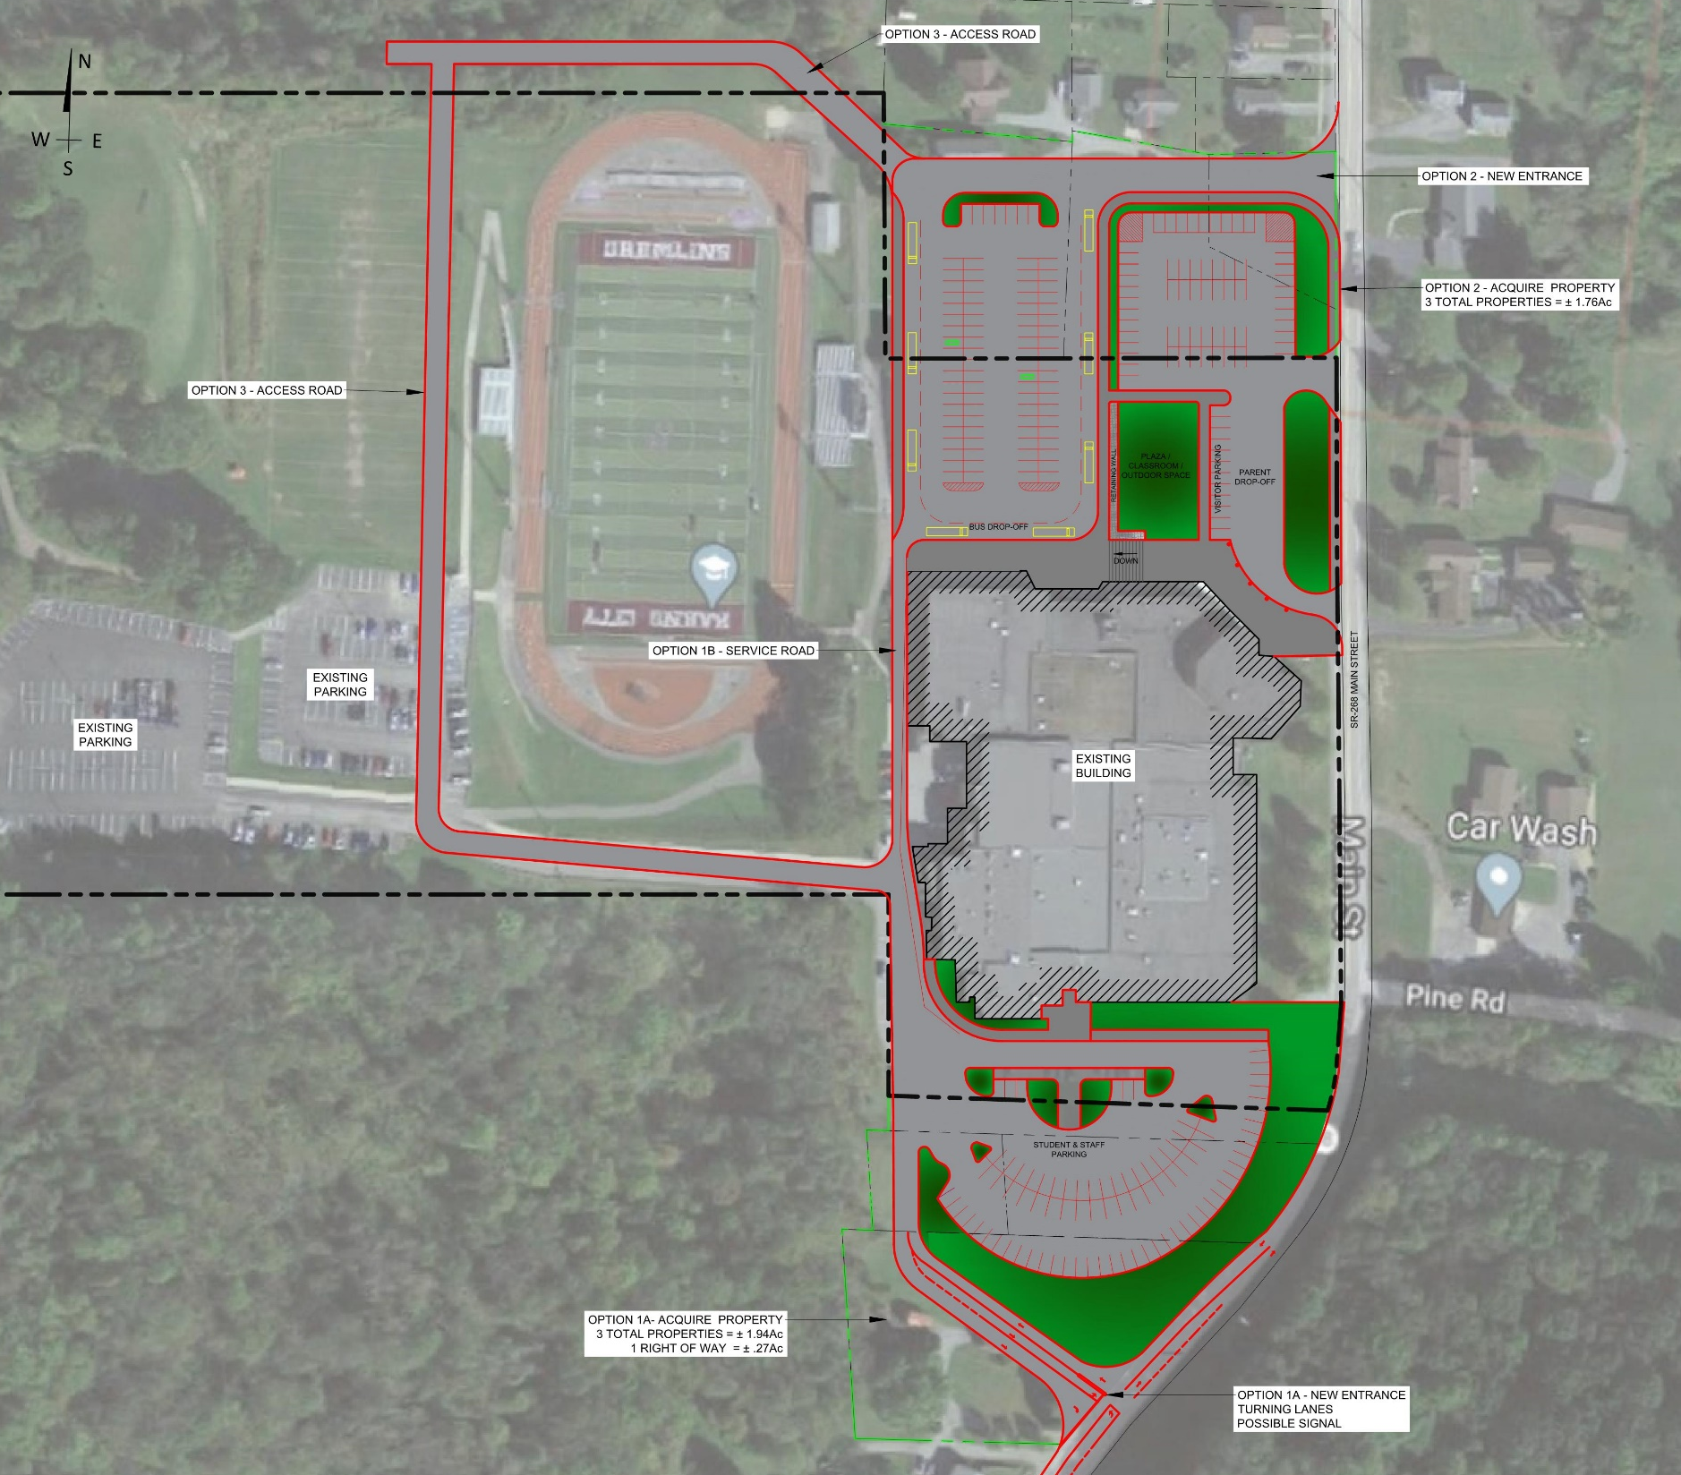
Option B
OPTION 3
High School Site Plan
Option A (3 properties)
New entrance and turning lane to improve vehicular circulation during Stadium events.
New student parking.
May require a traffic signal.
Option B (3 properties)
New entrance.
Separate bus and parent drop-off.
New visitor and staff parking.
New outdoor plaza.
New service drive (optional)
Option C (1 property)
Continuous driveway around property.
Option A

Slide 16
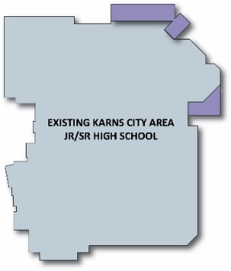
OPTION 3
Jr/Sr High School Floor Plan
Expand Admin., Guidance & Nurse.
Create Secure Vestibule
Separate Academic Spaces from Public Spaces.
Develop Main Street for building organization.
Open collaboration areas.
Storage addition for adjacent to Stage.
Ground Floor
First Floor

Slide 17
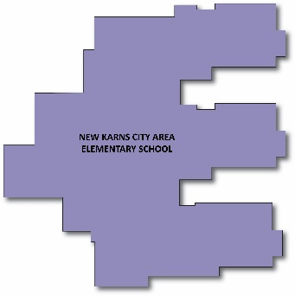
OPTION 8a & 8b
OPTION 8
K-6: New Elementary School (requires site acquisition)
7-12: Jr/Sr High School – Renovations w/minor additions

Slide 18
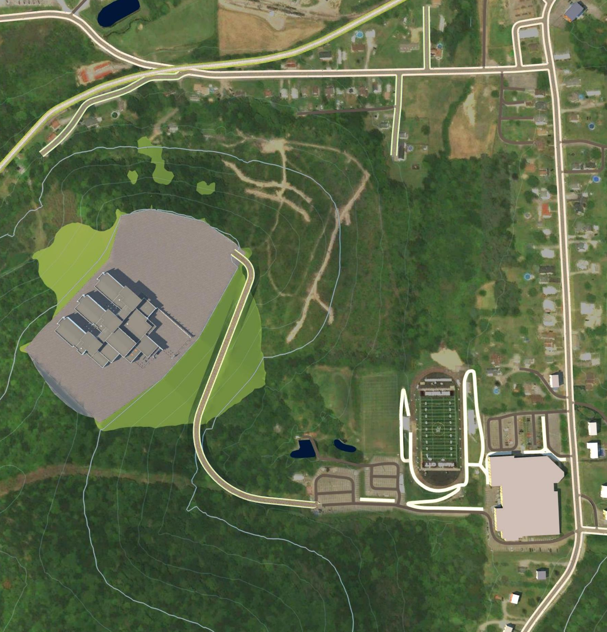
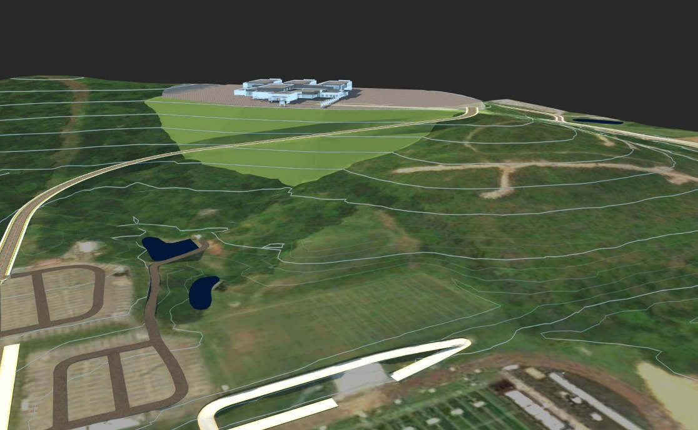
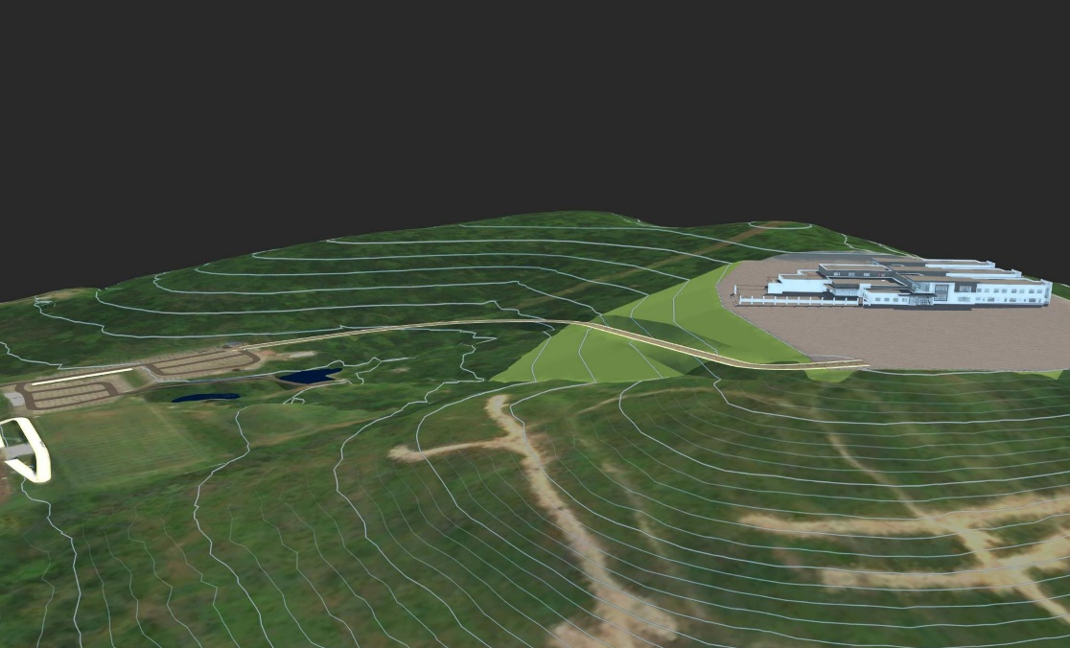
OPTION 8a
New Elementary Site Plan
CONCEPT 1

Slide 19
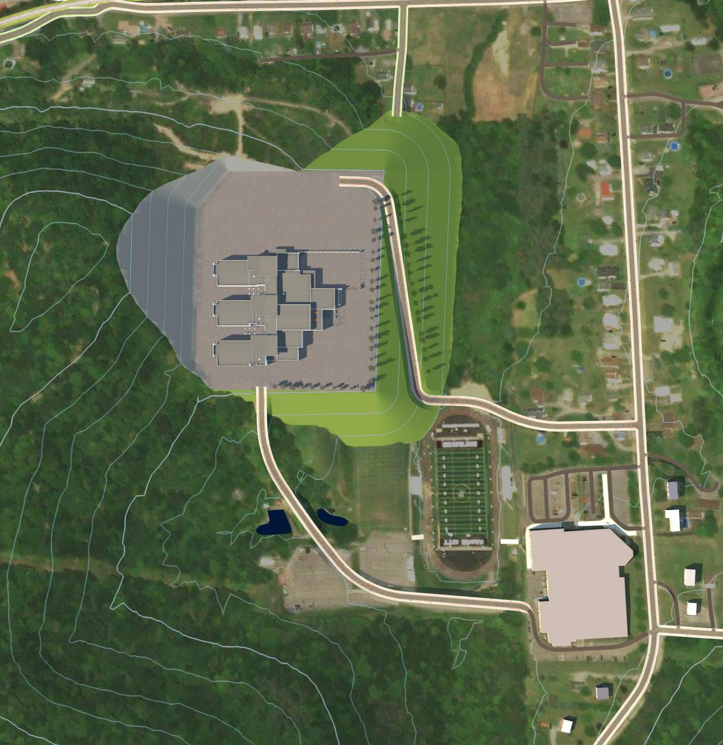
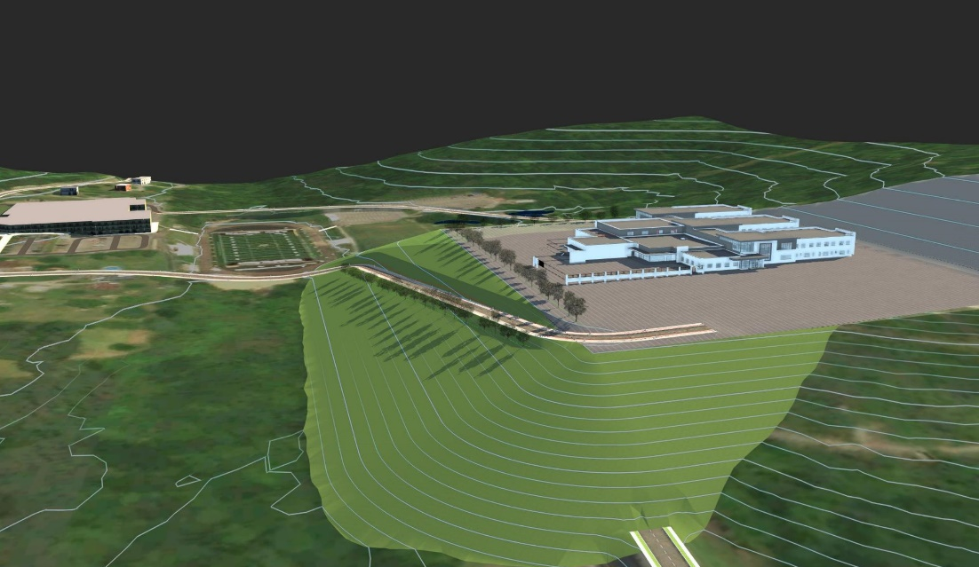
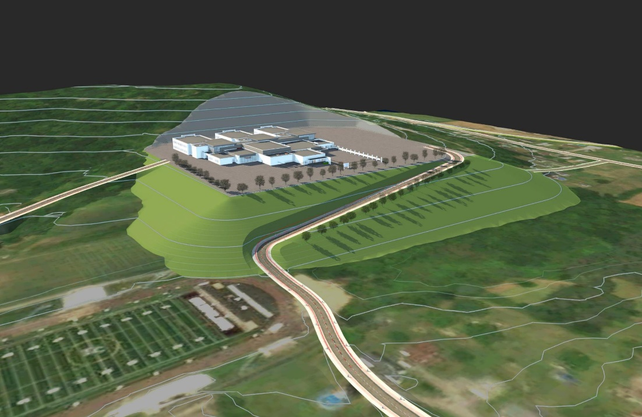
OPTION 8a
New Elementary Site Plan
CONCEPT 2

Slide 20
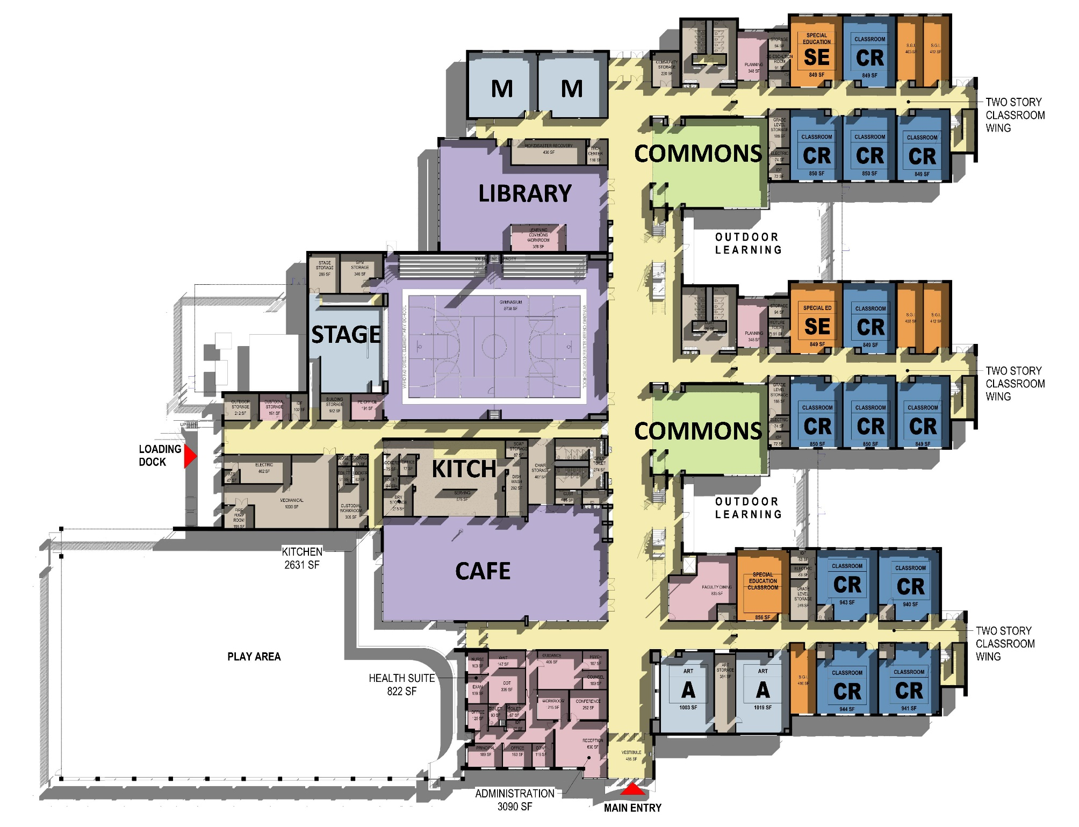
OPTION 8a
New Elementary
Floor Plan
Conceptual floor plan to accommodate grade level separation and projected enrollment (125,500 SF)
Main Street separates Academic Spaces (2 floors) from Public Spaces.
Open collaboration areas.
First Floor

Slide 21
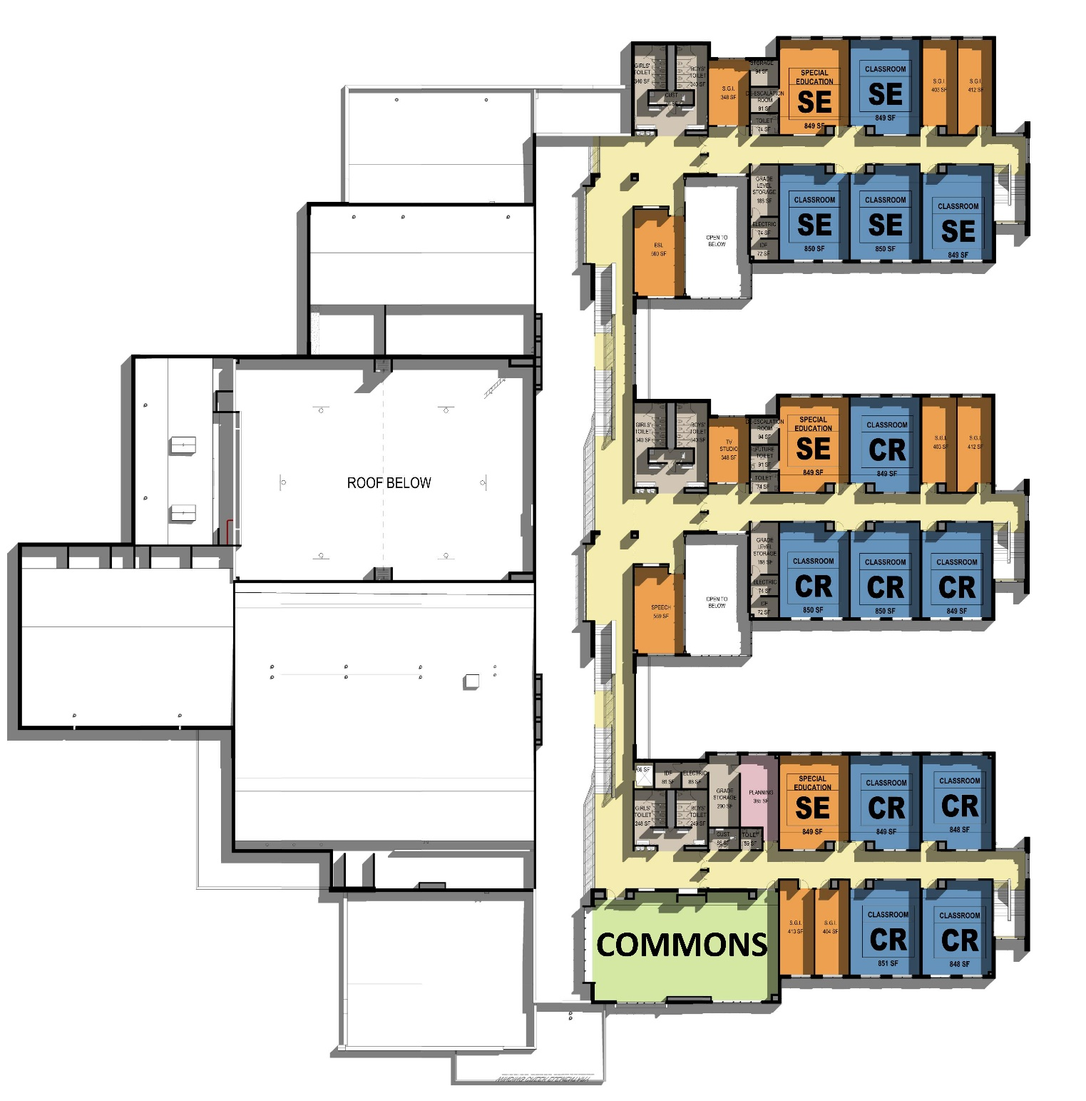
OPTION 8a
New Elementary
Floor Plan
Second Floor

Slide 22
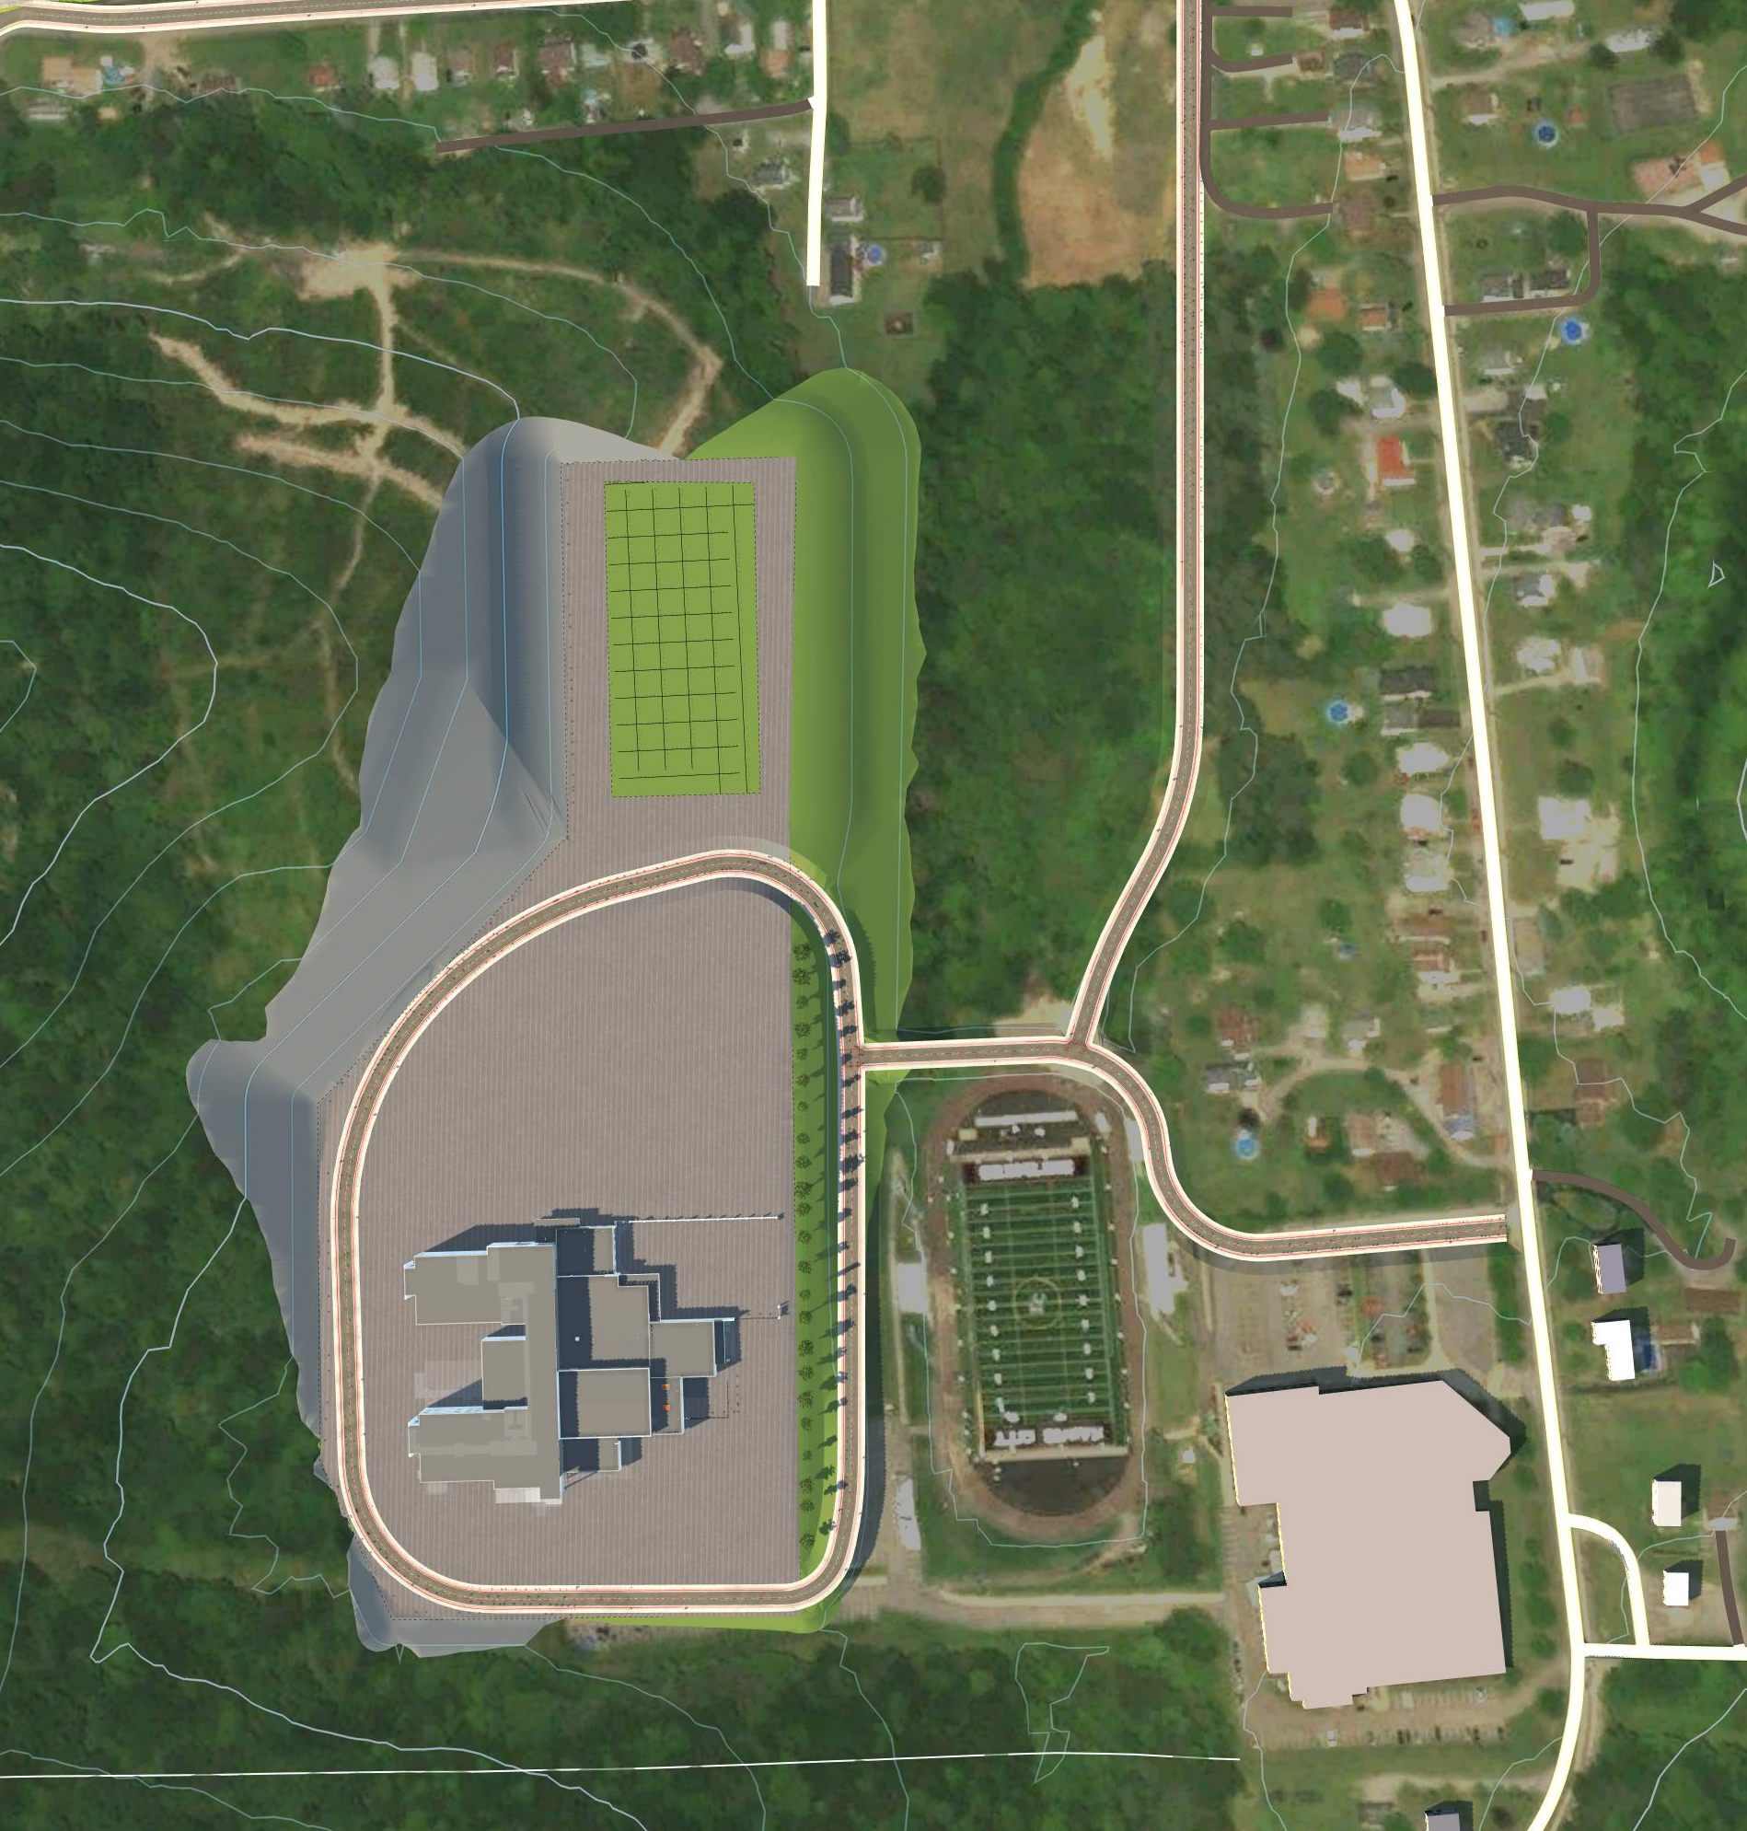
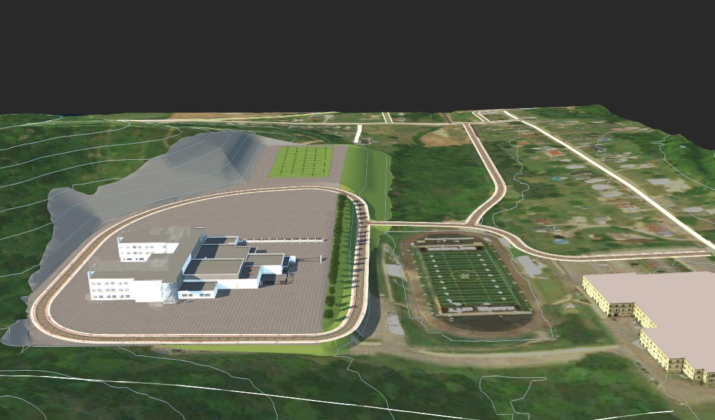
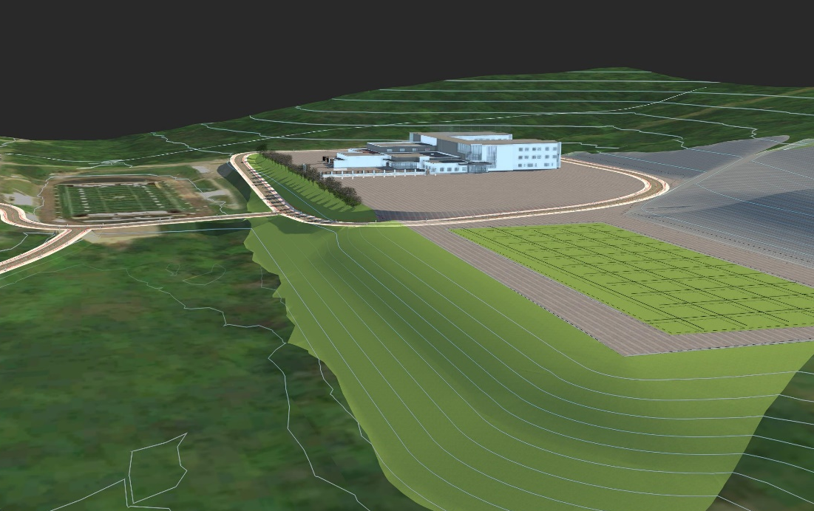
OPTION 8b
New Elementary Site Plan
CONCEPT 3

Slide 23
OPTION 8b
New Elementary
Floor Plan
Conceptual floor plan to accommodate grade level separation and projected enrollment (131,500 SF)
Main Street separates Academic Spaces (3 floors) from Public Spaces.
Open collaboration areas.
First Floor

Slide 24
OPTION 8b
New Elementary
Floor Plan
Second Floor
Third Floor

Slide 25
OPTION 8a &b
Jr/Sr High School Floor Plan
Expand Admin., Guidance & Nurse.
Create Secure Vestibule
Separate Academic Spaces from Public Spaces.
Separate Jr High from Sr. High
Develop Main Street for building organization.
Open collaboration areas.
Storage addition for adjacent to Stage.
Ground Floor
First Floor

Slide 26
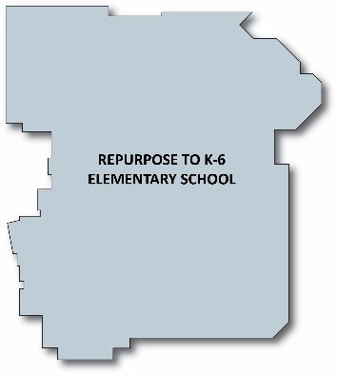
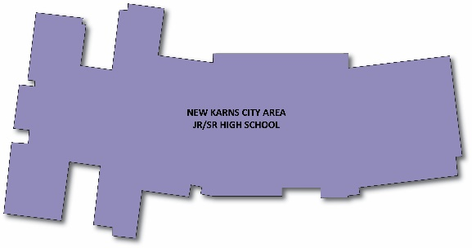
OPTION 10
OPTION 10
K-6: Repurpose existing HS to ES
7-12: New Jr/Sr High School (requires site acquisition)

Slide 27
OPTION 10
Elementary School
Floor Plan
Create Secure Vestibule
Separate Academic Spaces from Public Spaces.
Separate K-1 from 2-5.
Include open collaboration areas.
LIBRARY
LGI
Ground Floor
First Floor

Slide 28
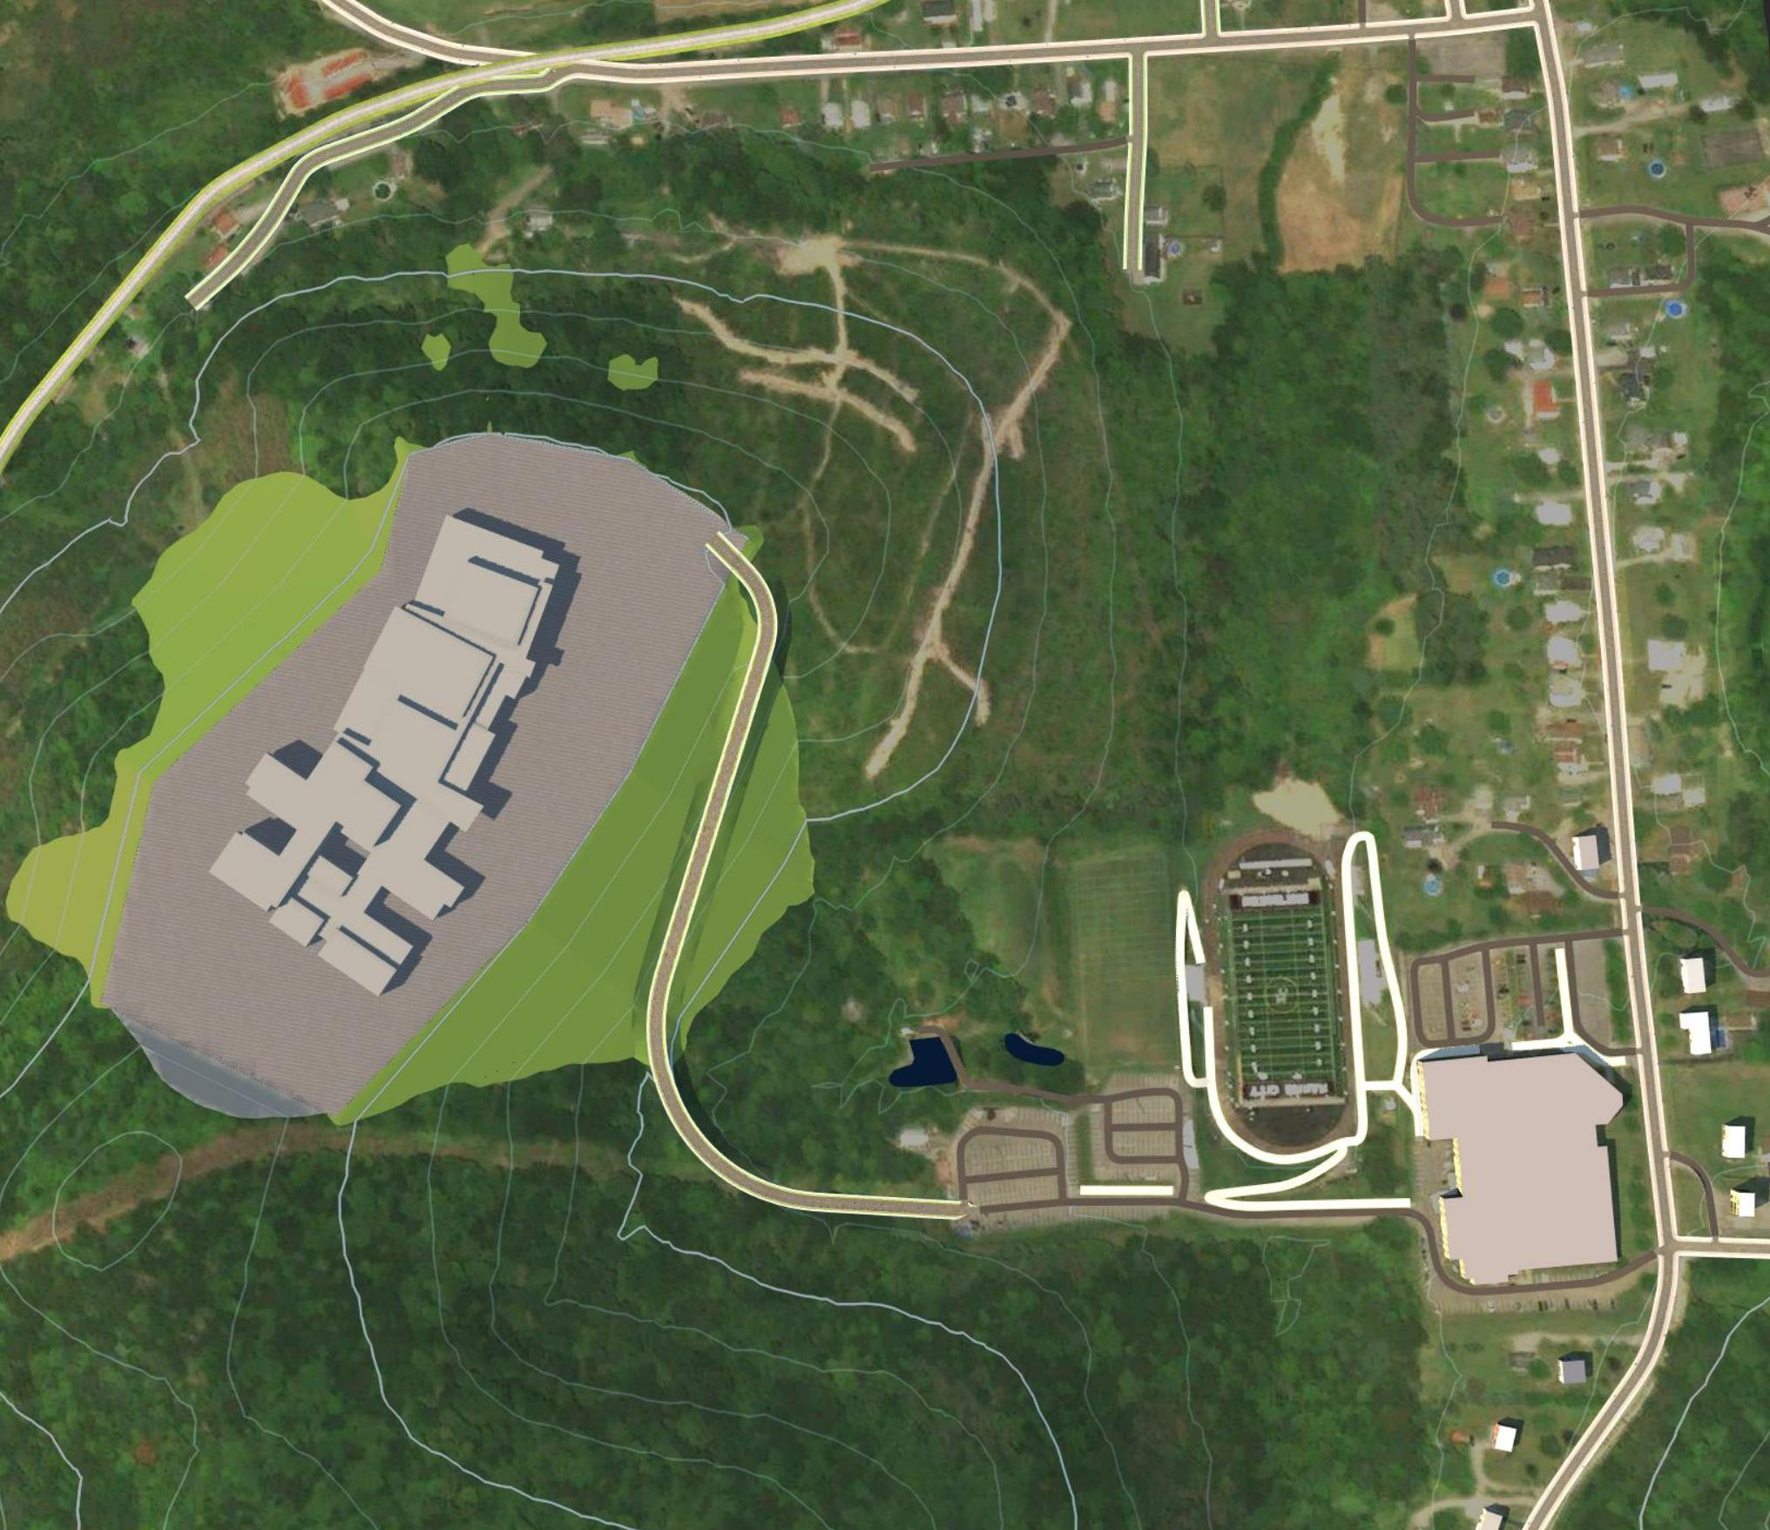
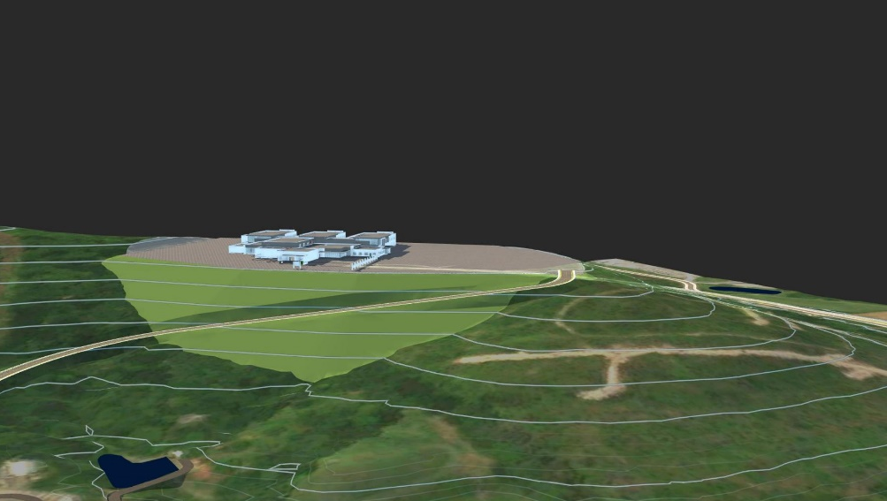
OPTION 10
New High School
Site Plan

Slide 29
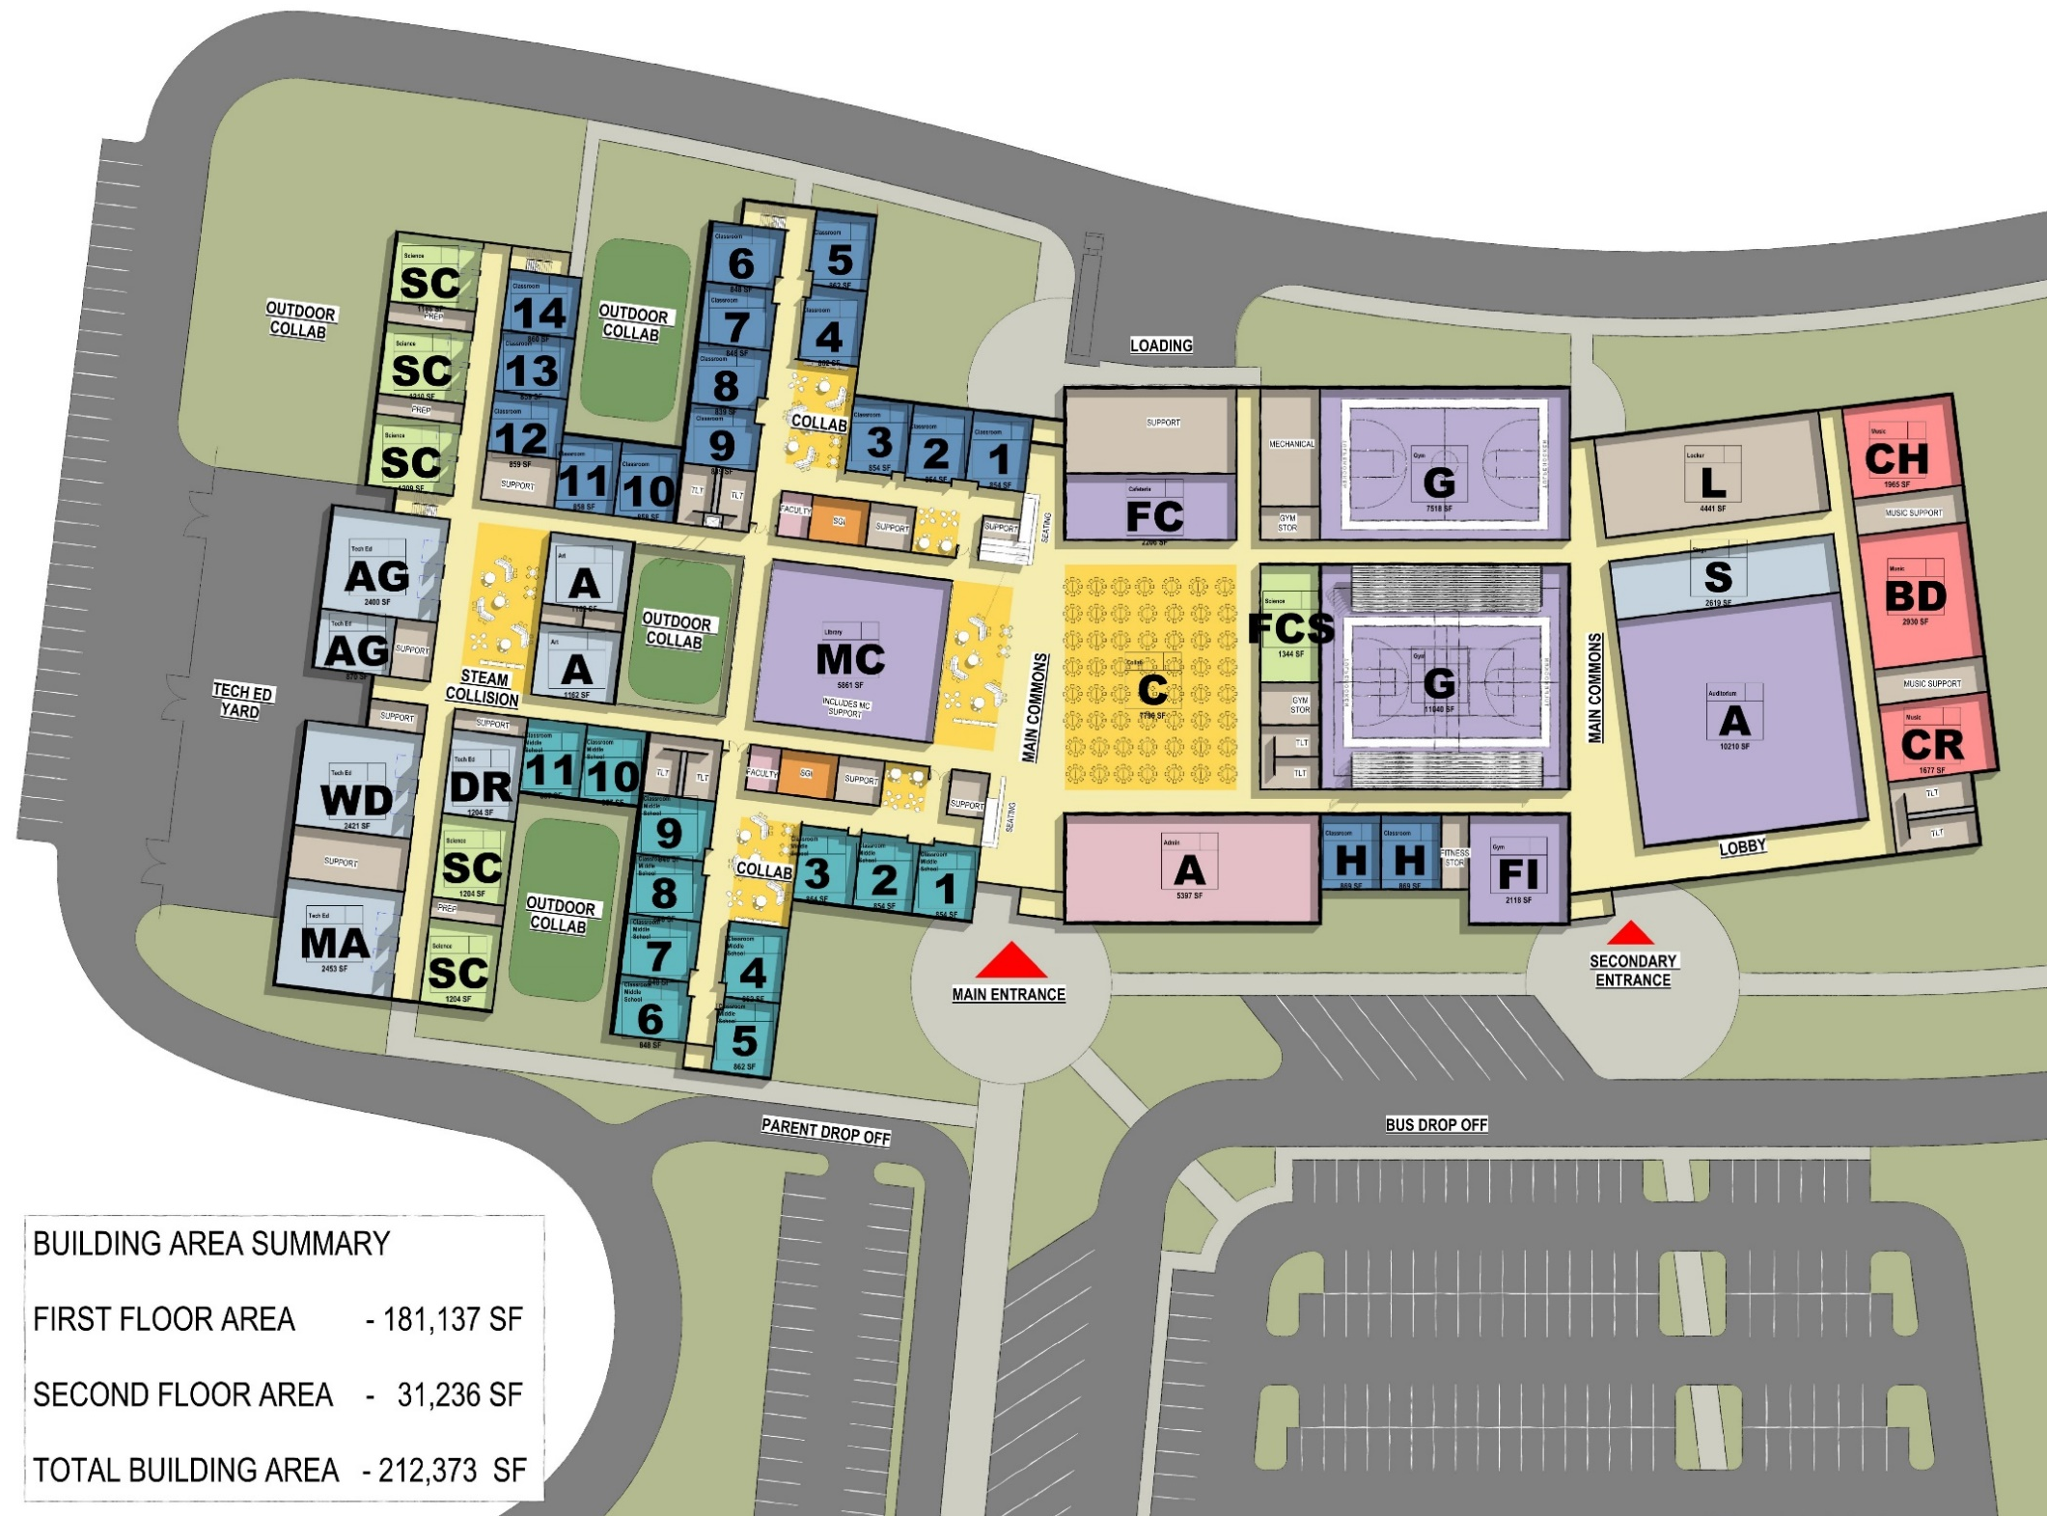
OPTION 10
New High School
Floor Plan
Conceptual floor plan to accommodate grade level separation and projected enrollment.
Create Secure Vestibule
Separate Academic Spaces from Public Spaces.
Develop Main Street for building organization.
Secondary entrance for evening events.
Include open collaboration areas.

Slide 30
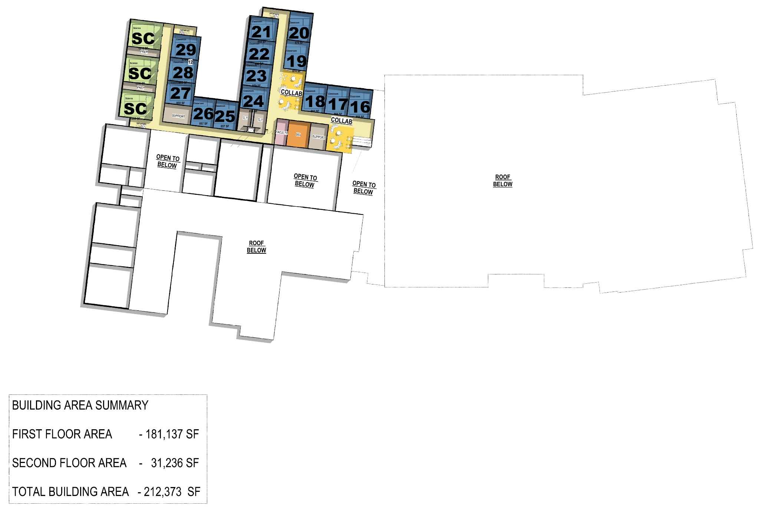
OPTION 10
New High School
Floor Plan

Slide 31
3 COST ESTIMATE

Slide 32
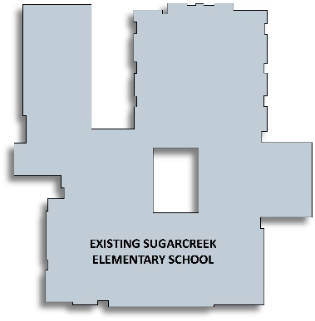
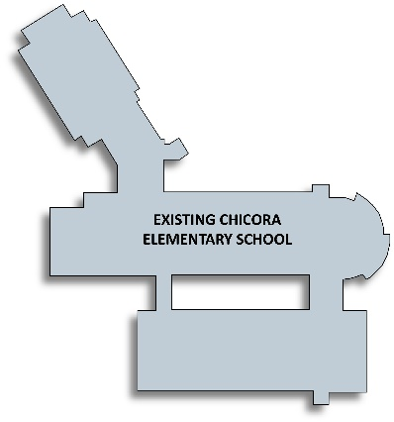
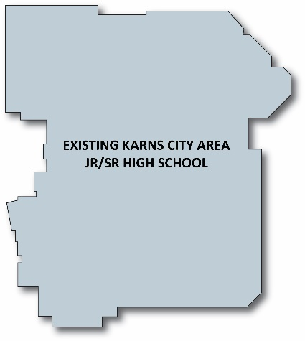
COST ESTIMATE
OPTION 1
COST RANGE
Sugarcreek ES Renovations
Construction Costs: $8.0M $9.2M
Soft Costs: $1.5M $1.6M
Total Costs: $9.5M $10.8M
Chicora ES Renovations
Construction Costs: $9.6M $10.9M
Soft Costs: $1.7M $2.0M
Total Costs: $11.3M $12.9M
Jr/Sr High School Renovations
Construction Costs: $20.4M $21.9M
Soft Costs: $3.7M $4.0M
Total Costs: $24.1M $25.9M
OPTION 1 TOTAL: $44.9M $49.6M
*Cost estimates does not include site improvement costs for Sugarcree ES

Slide 33
COST ESTIMATE
OPTION 3
COST RANGE
Chicora ES Additions & Renovations
Construction Costs: $15.7M $17.1M
Soft Costs: $2.8M $3.0M
Total Costs: $18.5M $20.1M
Jr/Sr High School Additions & Renovations
Construction Costs: $24.9M $26.4M
Soft Costs: $4.5M $4.8M
Total Costs: $29.4M $31.2M
OPTION 3 TOTAL: $47.8M $51.3M
*Cost estimates does not include site acquisition costs

Slide 34
COST ESTIMATE
OPTION 8a
COST RANGE
New Elementary School
Construction Costs: $31.5M $32.9M
Soft Costs: $5.7M $5.9M
Total Costs: $37.2M $38.8M
*Site Costs - $5.2-$5.9M
Jr/Sr High School Additions & Renovations
Construction Costs: $24.9M $26.4M
Soft Costs: $4.9M $5.3M
Total Costs: $29.8M $31.7M
OPTION 8 TOTAL: $67.0M $70.5M
*Cost estimates does not include site acquisition costs

Slide 35
COST ESTIMATE
OPTION 8b
COST RANGE
New Elementary School
Construction Costs: $34.8M $36.7M
Soft Costs: $6.2M $7.3M
Total Costs: $41.0M $44.0M
*Site Costs - $7.1-$8.2M
Jr/Sr High School Additions & Renovations
Construction Costs: $24.9M $26.4M
Soft Costs: $4.9M $5.3M
Total Costs: $29.8M $31.7M
OPTION 8 TOTAL: $70.8M $75.7M
*Cost estimates does not include site acquisition costs

Slide 36
COST ESTIMATE
OPTION 10
COST RANGE
Re-Purposed Elementary School
Construction Costs: $17.9M $19.1M
Soft Costs: $3.6M $3.8M
Total Costs: $21.5M $22.9M
New Jr/Sr High School
Construction Costs: $50.9M $53.6M
Soft Costs: $10.2M $10.7M
Total Costs: $61.2M $64.3M
OPTION 10 TOTAL: $82.7M $87.2M
*Cost estimates does not include site acquisition costs

Slide 37
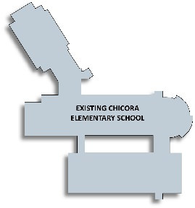
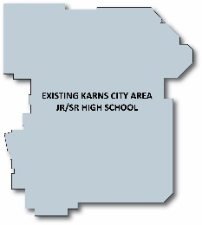
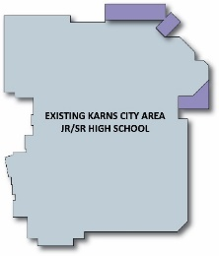
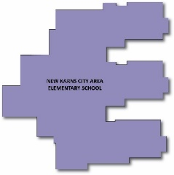
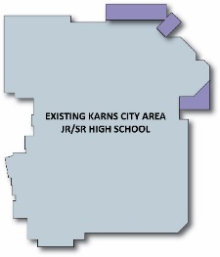
*Cost estimates include softs costs but do not include site acquisition costs
OPTION 1
COST ESTIMATE
COST RANGE
Sugarcreek ES $9.5M-$10.8M
Chicora ES: $11.3M-$12.9M
Jr/Sr High School: $24.1M-$25.9M
TOTAL: $44.9M-$49.6M
OPTION 3
Chicora ES: $18.5M-$20.1M
Jr/Sr High School: $29.4M-$31.2M
TOTAL: $47.8M-$51.3M
COST RANGE
OPTION 8a
COST RANGE
New Elementary: $37.8M-$39.5M
Jr/Sr High School: $29.8M-$31.7M
TOTAL: $67.6M-$71.2M
OPTION 10
COST RANGE
Repurposed Elem: $21.5M-$22.9M
New Jr/Sr High School: $61.2M-$64.3M
TOTAL: $82.7M-$87.2M

Slide 38
SCOPE OF WORK DESCRIPTION
LIMITED RENOVATION Scope of work to address specific building deficiencies. Does not address Educational Program
MODERATE RENOVATION Scope of work to address all building deficiencies including educational program without reconfiguration of spaces.
EXTENSIVE RENOVATION Scope of work to address all building deficiencies including educational program with reconfiguration of spaces.
ADDITIONS & RENOVATIONS Additional space to address projected enrollment and address existing building deficiencies and educational program.
NEW BUILDING New construction for cost comparison to renovate or replace.

Slide 39
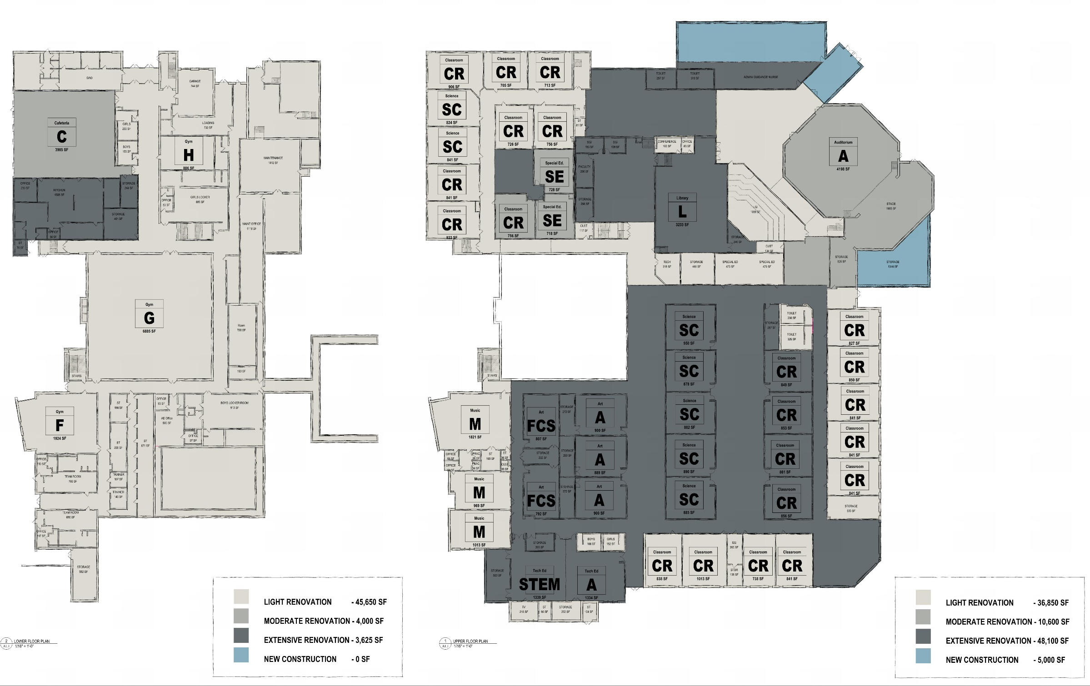
SCOPE OF WORK DESCRIPTION

Slide 40
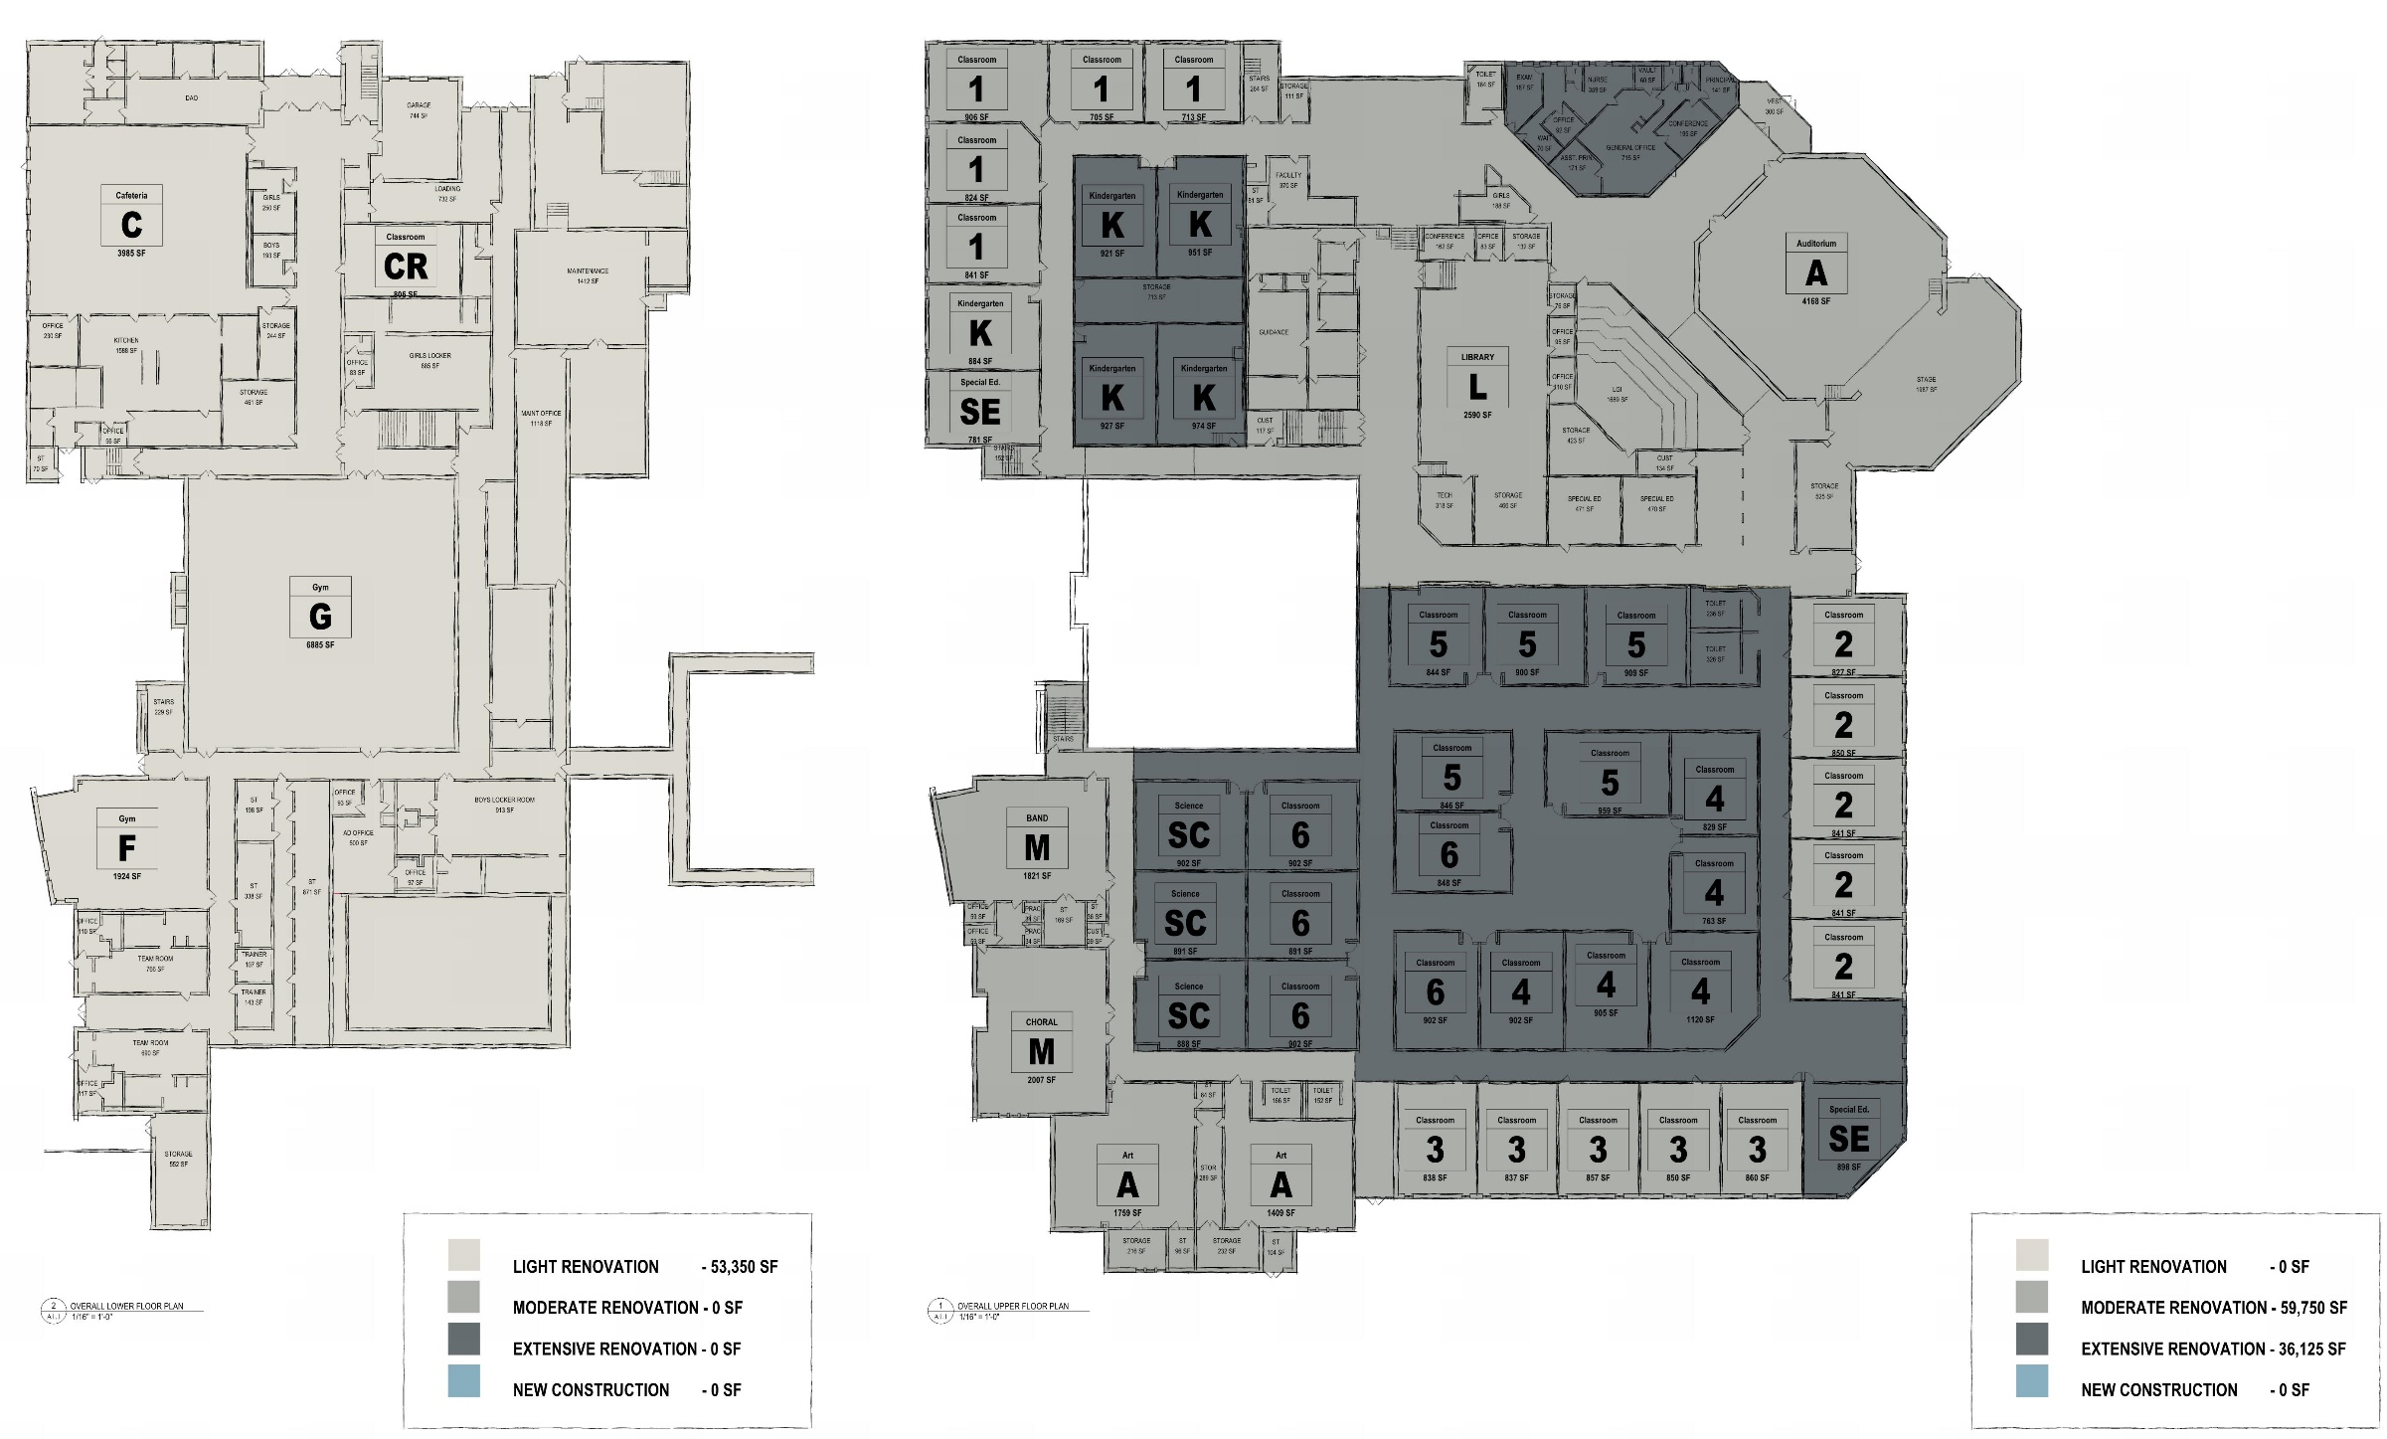
SCOPE OF WORK DESCRIPTION

Slide 41
4 PHASING

Slide 42
PHASING
OPTION 3
PHASE 1
Chicora ES Additions & Renovations $18.5-$20.1M
PHASE 2
Jr/Sr High School Renovations $21.2-$22.6M $26.5-$27.9M
Subtotal $39.7-$42.7M $45.0-$48.0M
PHASE 3 (Budget pending)
Site Acquisition & Development $2.9-$3.3M $2.9-$3.3M
Total $42.6-$46.0M $47.9-$51.3M
OPTION 1 OPTION 2
*Cost estimates does not include site acquisition costs

Slide 43
PHASING

Slide 44
5 NEXT STEPS

Slide 45
NEXT STEPS
Next Steps:
Establish financial parameters as Decision Making Process.
Community outreach and involvement.
Conduct due diligence on possible site acquisition.
Prioritize projects and establish a timeline.

Slide 46
Questions?

Slide 47
OPTION REVIEW
OPTION 1 Only address building deficiencies and does not address educational program needs.
OPTION 2 Existing High School can not accommodate additional grade level.
OPTION 3 Can existing site deficiencies at HS be addressed?
OPTION 4 Technically infeasible due to existing site conditions at HS.
OPTION 5 Can existing site deficiencies at HS be addressed and Admin addition developed? Consolidate with Option 3 as an alternate?
OPTION 6 Technically infeasible due to existing site conditions at HS.
OPTION 7 Technically infeasible due to existing site conditions at HS.
OPTION 8 Can a new elementary school be located on another site?
OPTION 9 Technically infeasible due to existing site conditions at HS.
OPTION 10 Can the existing High School be repurposed to a K-6 or K-8 and a new High School be building on another site?

